Slide 1
Economics Basic | Supply and Demand | Starting a business | Eh-conomy | CONNECT and APPLY
$100 | $100 | $100 | $100 | $200
$200 | $200 | $200 | $200 | $500
$300 | $300 | $300 | $300 | $600
$400 | $400 | $400 | $400 | $700

Slide 2
Your company’s cost of generating the revenue exceeds income earned from sales

Slide 3
What is a loss?
Notes:
Profit = Revenue – Expenses

Slide 4
A business is said to have this if they have the power to raise prices without losing customers

Slide 5
What are pricing power?
Notes:
Pricing power is VERY important

Slide 6
This refers to when a company is able to pay one’s debt
Notes:
Companies used to have pricing power (could charge what they want), but with competition consumers can shop around for the best deal.

Slide 7
What is solvent?

Slide 8
What are three questions economic systems ask?

Slide 9
What is 1) What should we produce? 2) Who gets the goods and services? 3) How will we produce the goods and services?

Slide 10
The quantity of good or service that CONSUMERS are willing to buy at a particular price

Slide 11
What is demand?

Slide 12
The quantity of good or service that BUSINESSES are willing to provide for range of prices people are willing to pay.

Slide 13
What is supply?

Slide 14
According to the law of demand, when prices are low, consumers buy more and demand goes ____.

Slide 15
What is up?
Notes:
Low price, consumers buy more, demand goes up.

Slide 16
According to what law that states if people are willing to pay more for a product, then businesses are willing to produce more of that product to increase revenue?

Slide 17
What is the law of supply?
Notes:
One example of the law of supply applies to fans of a football team who just won the championship to head to the Super Bowl. The week before the championship game, t-shirts and other items with the team logo were sold at typical prices that were equivalent to the prices of products with other team logos. However, once it's determined the team was headed to the Super Bowl, there is a run on the all of the team's merchandise. Retailers may double the price on the products and fans will continue to buy the products.

Slide 18
When starting a business, you need to finance your business (i.e money to start you business) What are the two types of financing called?

Slide 19
What is equity and debt financing?

Slide 20
Nikki Spencer has a small chain of clothes shops in the East Midland. Her biggest problem has been to raise capital to expand. Her only options have been to use her existing savings or to go the bank and borrow money but this costs interest as well. She is also aware that if she builds up debts she could suffer from unlimited liability. This means that she could lose her house as she is responsible for the debts. She has however really enjoyed the ability to make her own decisions, nobody is telling her what to do. Also as the sole owner, after she has paid her bills she can keep all of the profits. Use this scenario and list TWO advantage and TWO disadvantage of being a sole proprietorship.

Slide 21
What is Advantage: -You are your own boss -Profits don’t have to be shared Disadvantage: -Difficult of raising capital -Unlimited liability?

Slide 22
Scuffy the Tugboat is a family-run business that makes tugboats. It was formed as a partnership in 1986 by the three McLaughlin bothers. Their first tugboat is still towing ships in Boston harbor, and over the years, success has allowed them to grow the company. Last year’s sales were more than $7 million. Now, however, they want to double production by expanding their factory by twenty-four square feet. They estimate a cost of about $1 million, yet a bigger facility would enable them to avoid late-delivery penalties that can run up to $2,000 a day. They’re not sure, however, about the best way to raise the needed funds. None of the brothers has $1 million on hand, and lenders and local banks are often hesitant to loan money to shipbuilders. What business ownership would you recommend to Scuffy the Tugboat?

Slide 23
What is private corporation?

Slide 24
Meet Francine. She wants to start a business but doesn't have any experience in running a business and doesn't really have a killer idea for a business. While she's willing to take a degree of risk in starting a new business, she doesn't want to go too far out on a limb. What type of ownership is best for her and list ONE advantage of this ownership?

Slide 25
What is franchise Advantage: in franchise, most of the work has already been done, so she has to just follow instructions
Notes:
OR association to a famous name – less risk

Slide 26
This sector of an economy involves the extraction of raw materials from the Earth. A worker in this sector includes farmers and coal miners.

Slide 27
What is a primary sector?

Slide 28
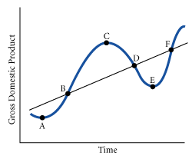
For the given graph, during which period is the economy considered to be in a recession?

Slide 29
What is period C to E?
Notes:
It is possible for the level of output to be high, yet the economy is in a recession. A recession is a period of time from peak to trough

Slide 30
Pick the correct choice: Economists define depression as: a) the same as a recession b) a common economic event c) a common psychological illness d) a prolonged period where GDP falls more than 10% than a recession e) unemployment rate higher than 20%

Slide 31
What is d)?
Notes:
Depression is a prolonged period which can last several years

Slide 32
According to this chart, which year experienced a peak in the business cycle?

Slide 33
What is year 1993?

Slide 34
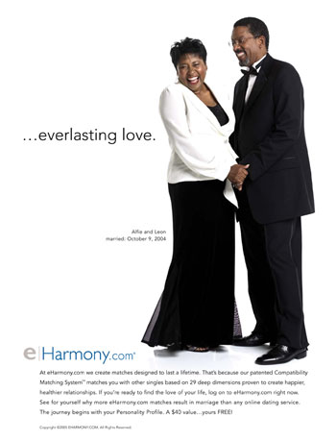
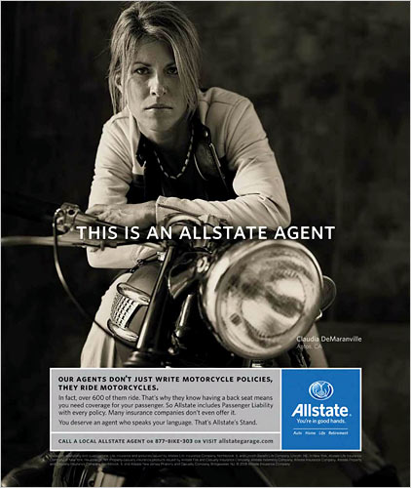
These ads appeal to which category(ies) of Maslow’s hierarchy?

Slide 35
What is love and belonging (E-harmony ad) and safety (Allstate ad)?
Notes:
This ad for Allstate appeals to Maslow’s second need category, safety. It tells consumers that their insurance will take care of them financially in the event of an accident.

Slide 36
What type of management include job titles such as division manager, branch manger, and site manager?

Slide 37
What is Middle-Level Management?

Slide 38
What is the real GDP per capita of an economy that has 20 people and real GDP of $1,000,000?

Slide 39
What is 50, 000?

Slide 40
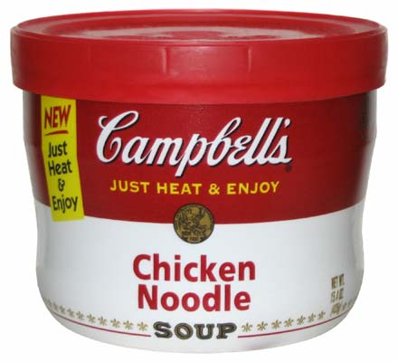
Think of a product such as a can of super noodle soup and what goes into making it. Look at the three statements below and identify which one is a natural, human and capital resource: 1) Farmers raise the livestock and crops 2) Grocery stores need shelves to stock the soup as well label markers to label price 3) The chicken and vegetable were from crops and live stock raised on farms.

Slide 41
What is statement 1-human resource statement 2-capital resource statement 3-natural resource

