Slide 1
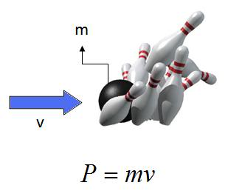
Ch5: Momentum & Collisions
5.1 – Momentum & Impulse (pg. 222-227)

Slide 5
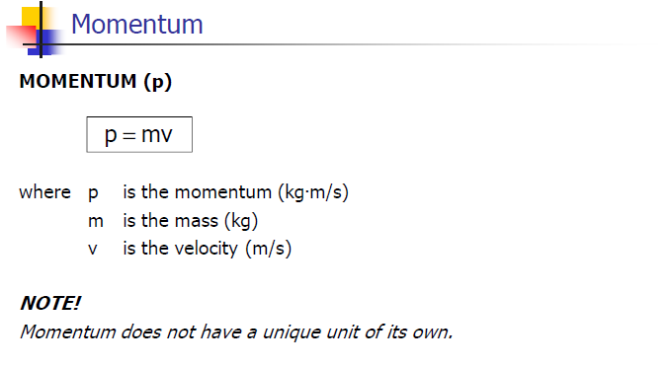

Slide 7
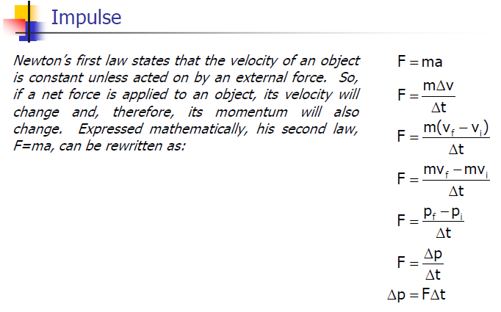

Slide 8
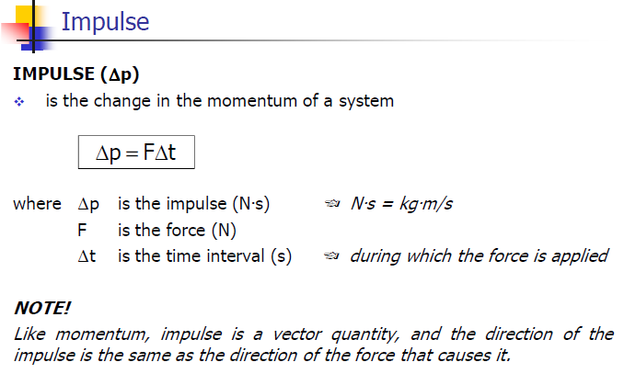

Slide 23
Classwork & Homework

