Slide 1
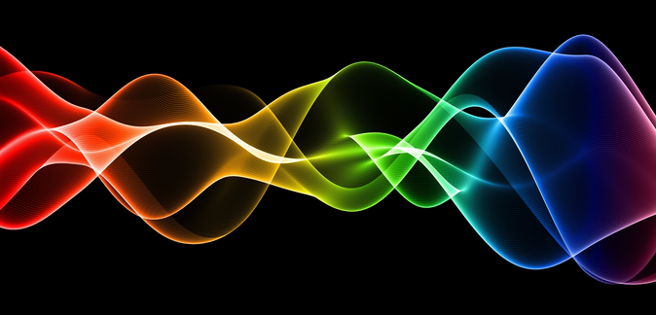
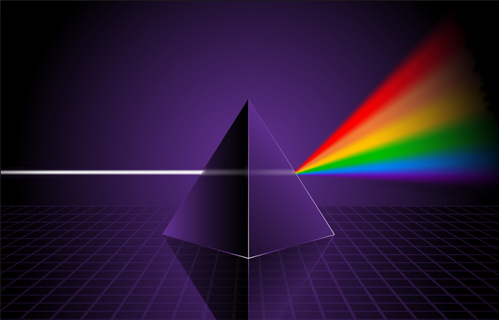
Ch10: Applications of the Wave Nature of Light
10.1 – Newton’s Rings and Air Wedges
(pg. 508-511)

Slide 7
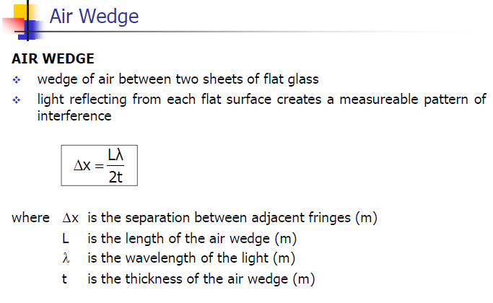

Slide 11
Classwork & Homework

