Slide 1
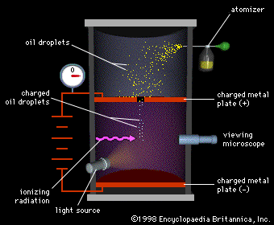
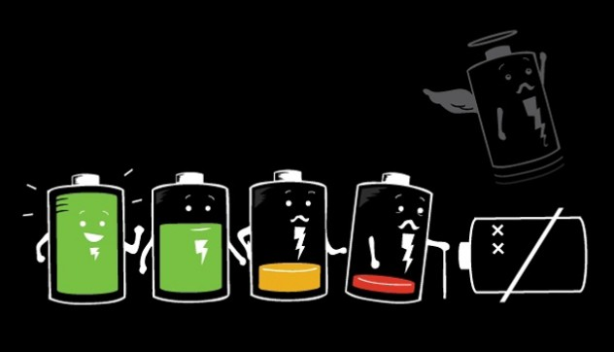
Ch7: Electric Fields
7.3 – Electric Fields (pg. 338-345)

Slide 6
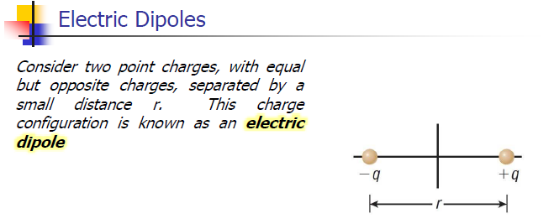

Slide 18
Classwork & Homework

