Slide 1
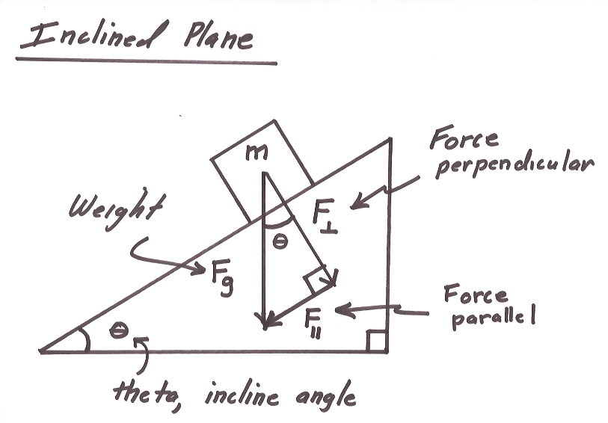
Ch2: Dynamics
2.4 – Forces of Friction (pg. 84-90)

Slide 5
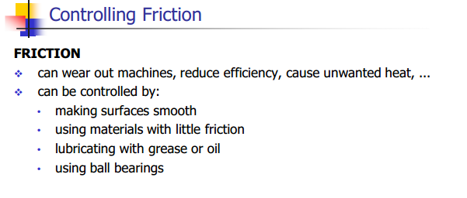

Slide 8
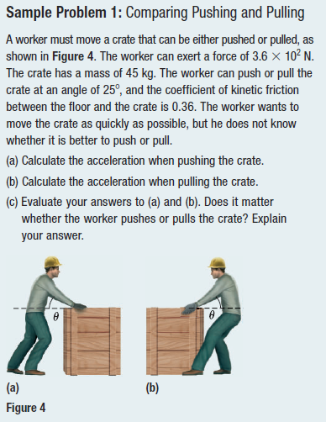
Q1: Comparing Pushing & Pulling

Slide 11
Q2: Inclined Plane & Friction
A sled takes off from the top of a hill inclined at 6.0° to the horizontal. The sled’s initial speed is 12m/s. The coefficient of kinetic friction between the sled and the snow is 0.14. Determine how far the sled will slide before coming to rest.

Slide 14
Q3: Connected Objects & Friction

Slide 20
Classwork & Homework

