Slide 1
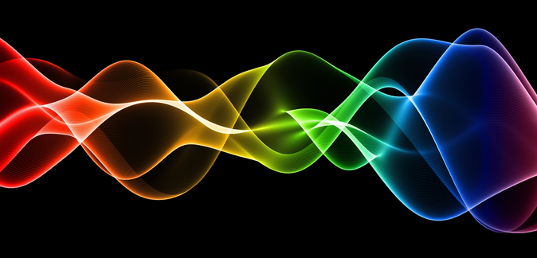
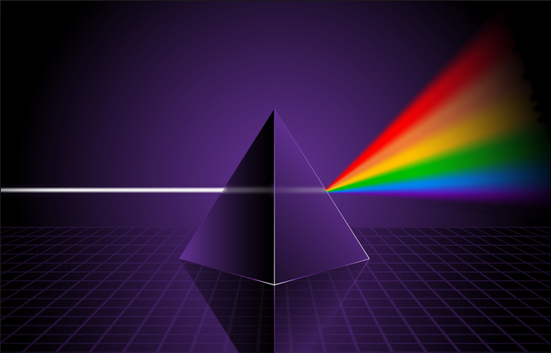
Ch10: Applications of the Wave Nature of Light
10.1 – Interference in Thin Films (pg. 502-507)

Slide 14
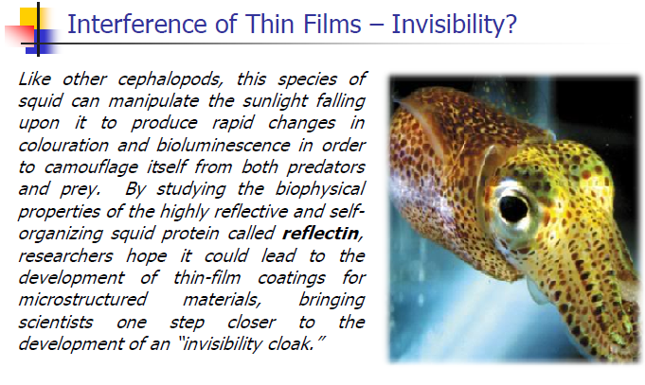

Slide 21
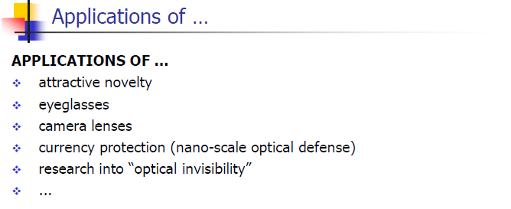

Slide 22
Classwork & Homework

