Slide 1
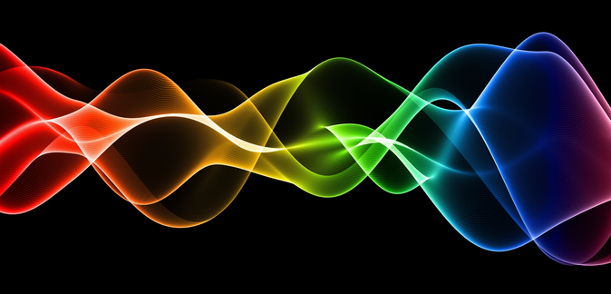
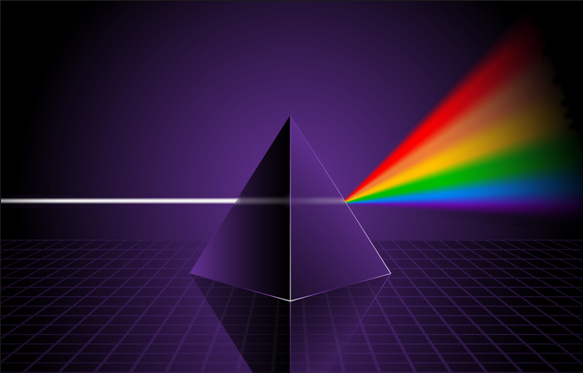
Ch9: Waves and Light
9.5 – Interference of Light Waves: Young’s Double-Slit Experiment (pg. 477-484)

Slide 20
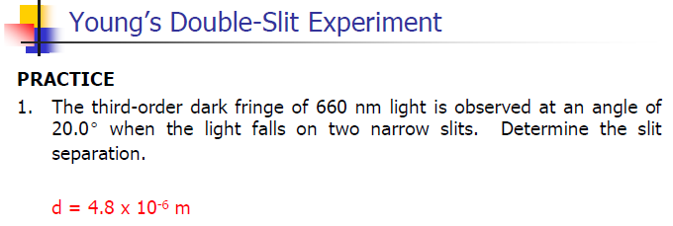

Slide 39
Classwork & Homework

