Slide 1
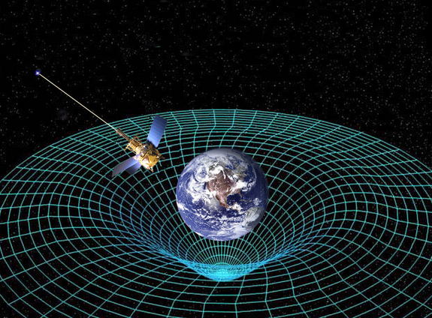
Ch11: Relativity
11.3 – Simultaneity & Twin Paradox
(pg. 591-594)

Slide 14
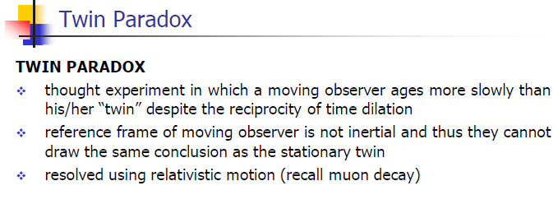

Slide 18
Classwork & Homework

