Slide 1
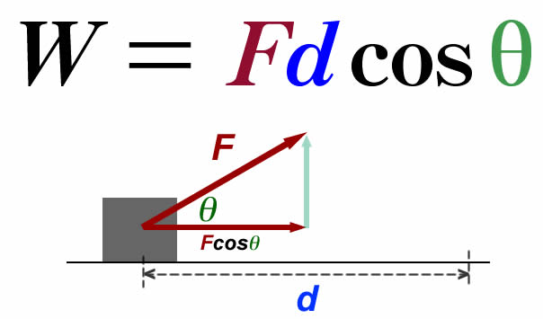
Ch4: Work & Energy
4.5 – The Law of Conservation of Energy
(pg. 184-191)

Slide 13
Classwork & Homework

