Slide 1
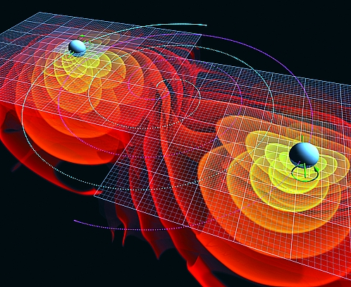
Ch6: Gravitational Fields
6.2 – Orbits (pg. 297-303)

Slide 2
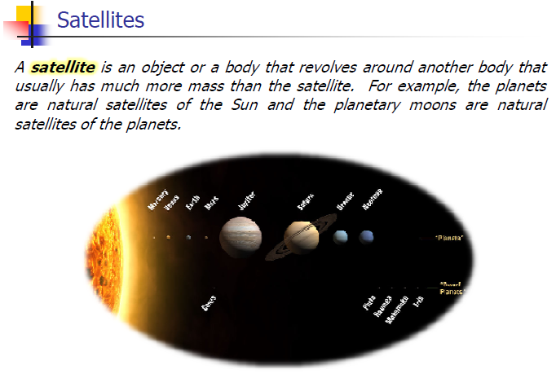

Slide 3
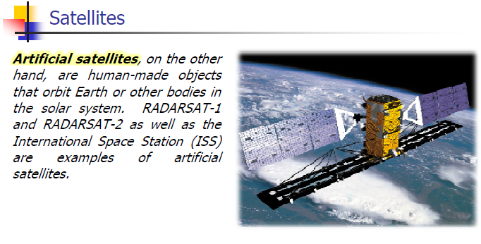

Slide 7
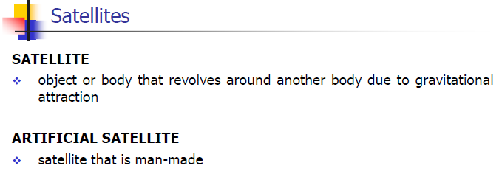

Slide 12
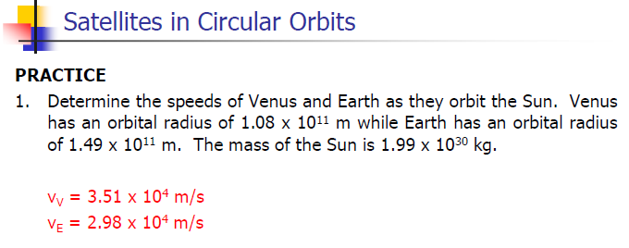

Slide 16
Classwork & Homework

