Slide 1
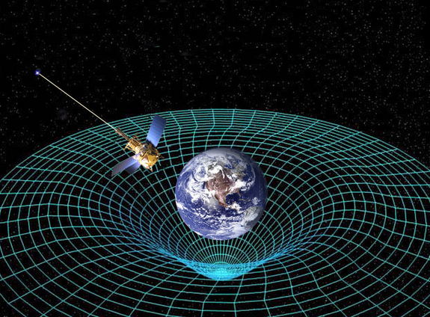
Ch11: Relativity
11.2 – Time Dilation (pg. 580-587)

Slide 5
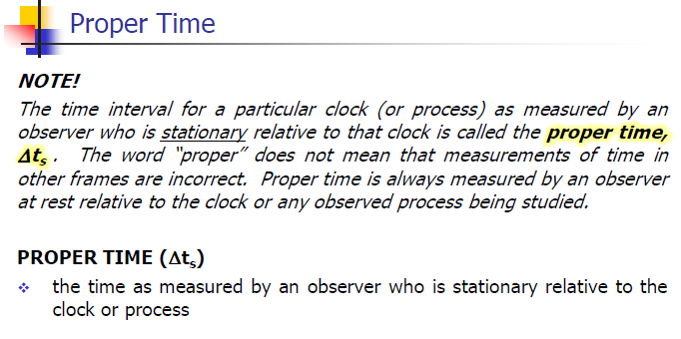

Slide 7
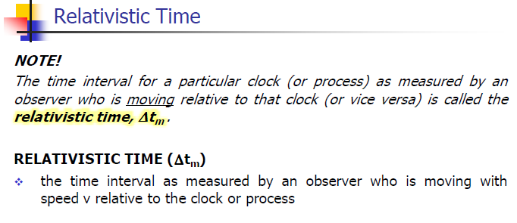

Slide 13
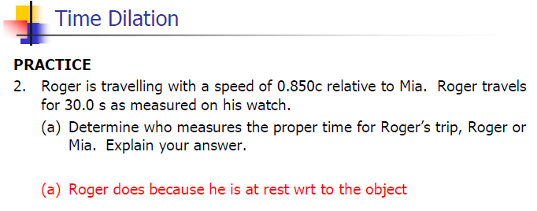

Slide 14
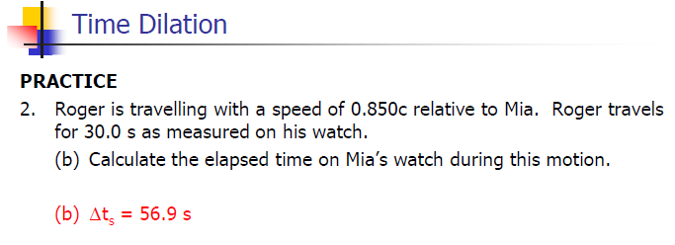

Slide 23
Classwork & Homework

