Slide 1
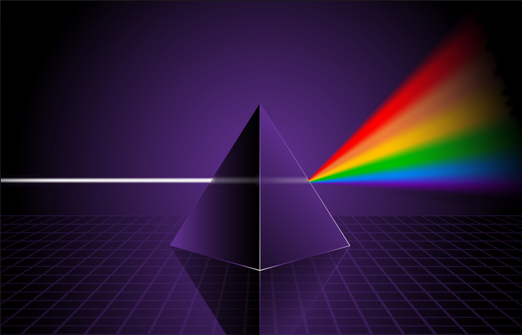
Ch9: Waves and Light
9.3 – Properties of Waves and Light (pg. 459-461)

Slide 9
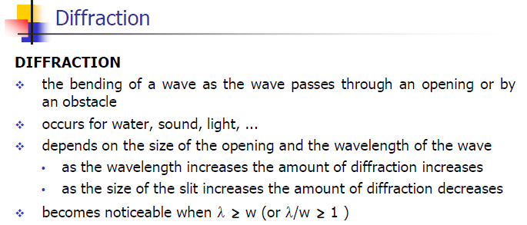

Slide 15
Classwork & Homework

