Slide 2
2.1 & 2.2 - Motion in Two Dimensions - A Scale Diagram and Algebraic Approach

Slide 6
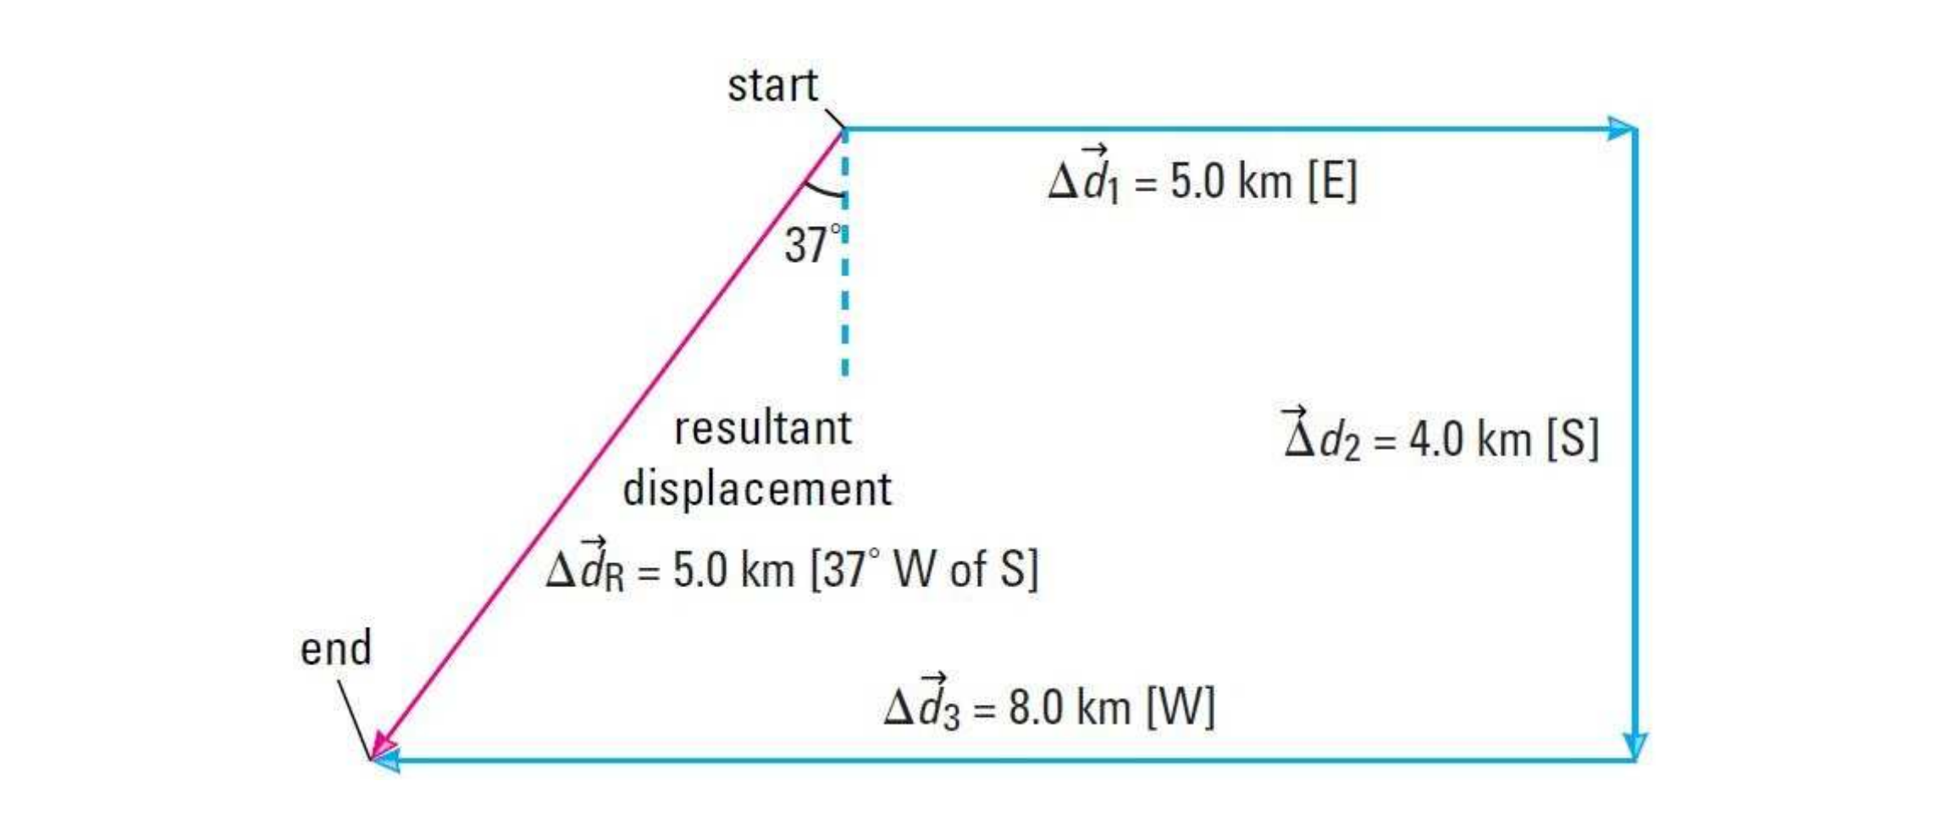

Slide 9
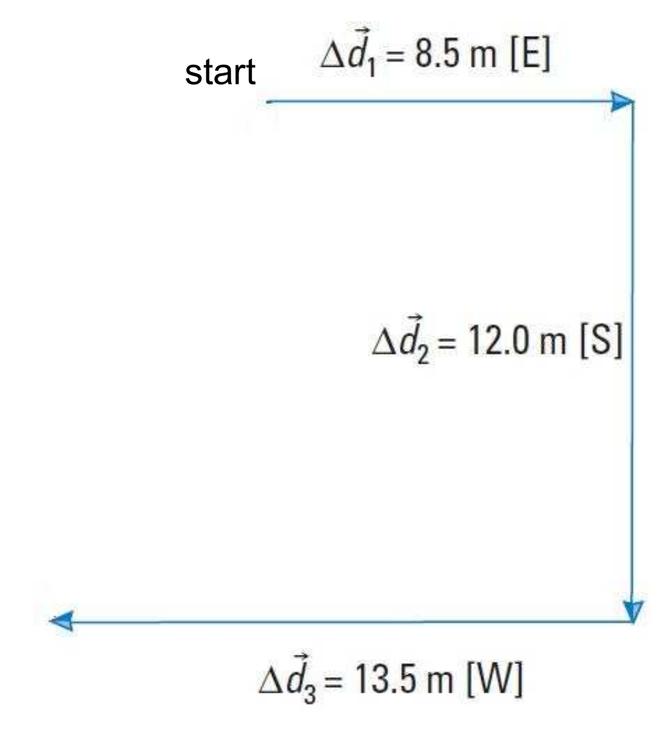

Slide 11
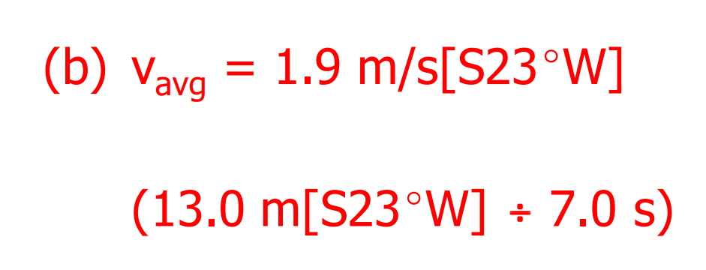

Slide 18
A hockey puck travels a displacement of 4.2m [S38°W]. It is then struck by a hockey players stick and undergoes a displacement of 2.7m [E25°N]. What is the puck’s total displacement?

Slide 19
A hockey puck travels a displacement of 4.2m [S38°W]. It is then struck by a hockey players stick and undergoes a displacement of 2.7m [E25°N]. What is the puck’s total displacement?

