Slide 2
2.1 & 2.2 - Motion in Two Dimensions - A Scale Diagram and Algebraic Approach

Slide 6
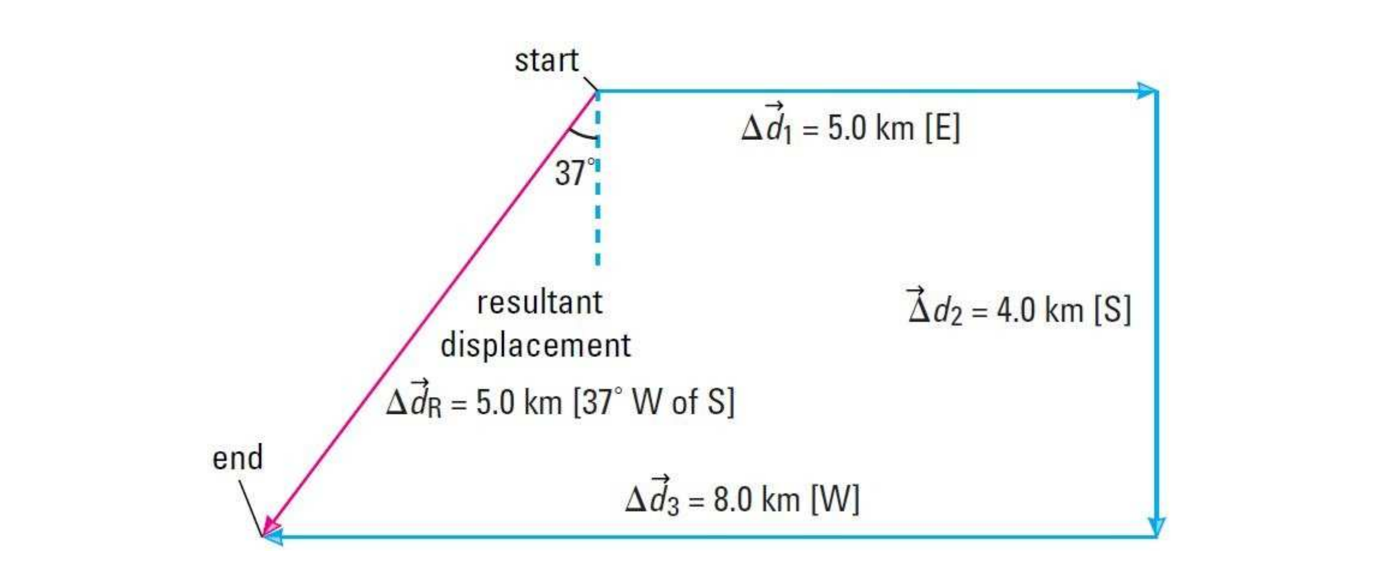

Slide 8
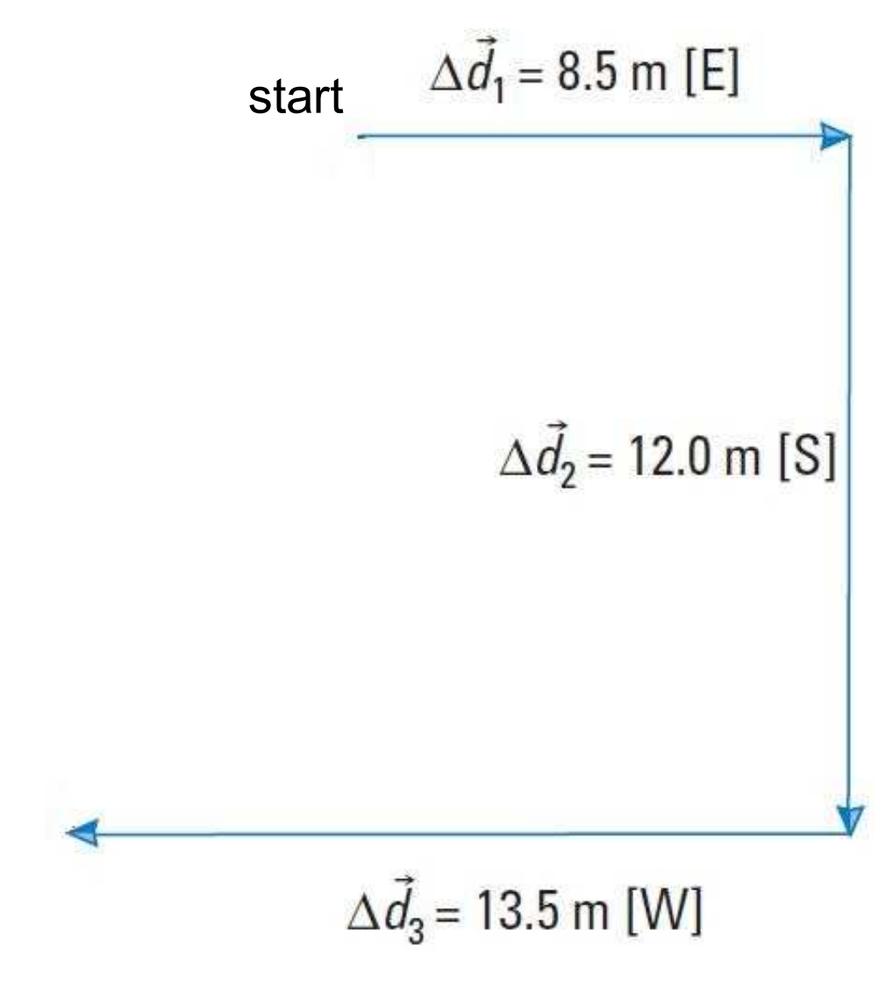

Slide 10
