Slide 1
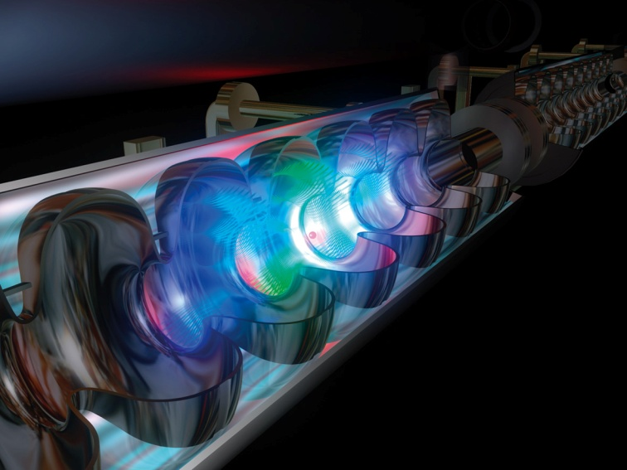
Ch8: Magnetic Fields
8.3 – Magnetic Force on a Current-Carrying Conductor
(pg. 392-396)

Slide 10
Classwork & Homework

