Slide 1
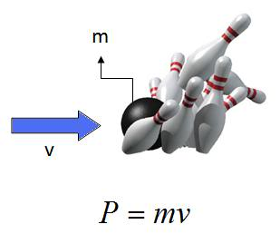
Ch5: Momentum & Collisions
5.5 – Conservation of Momentum in
Two Dimension (pg. 249-253)

Slide 9
Classwork & Homework

