Slide 1
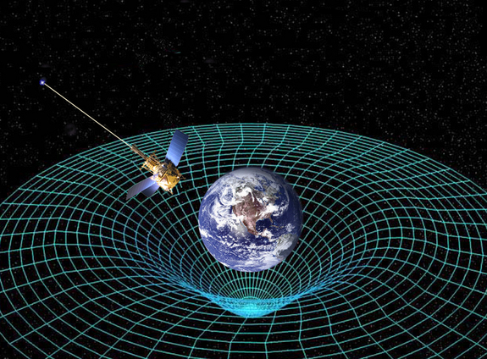
Ch12: Quantum Mechanics
12.6 – The Standard Model of Elementary Particles
(pg. 644-653)

Slide 6
Classwork & Homework

