Slide 1
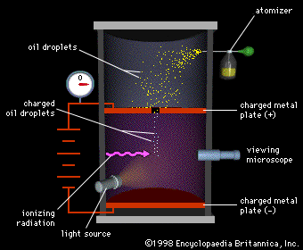
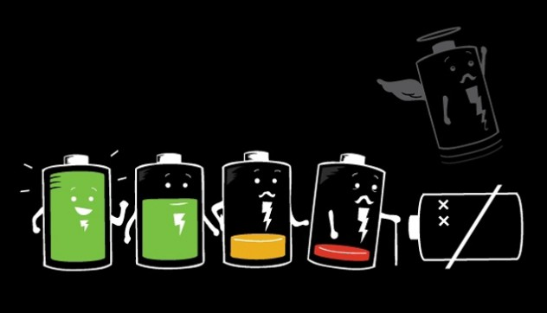
Ch7: Electric Fields
7.6 – The Millikan Oil Drop Experiment
(pg. 362-364)

Slide 5
Millikan Drop Experiment
http://www.youtube.com/watch?v=UFiPWv03f6g

Slide 12
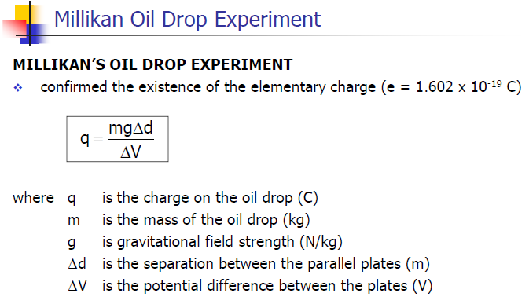

Slide 17
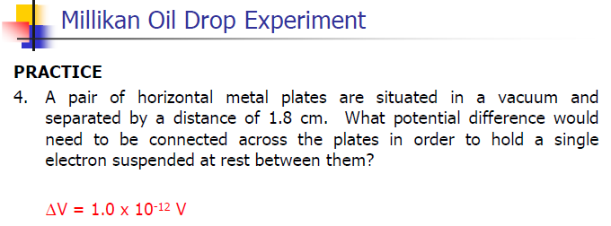

Slide 19
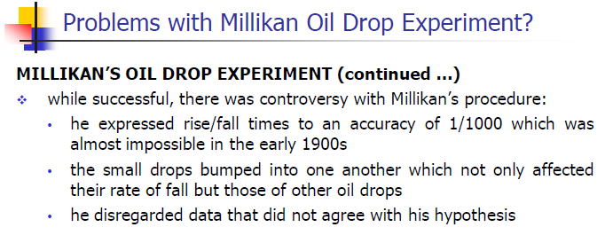

Slide 25
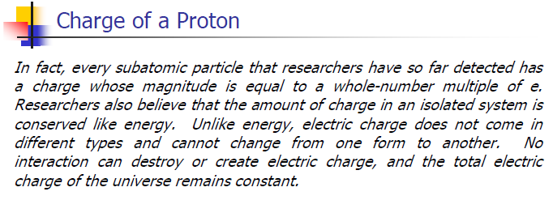

Slide 27
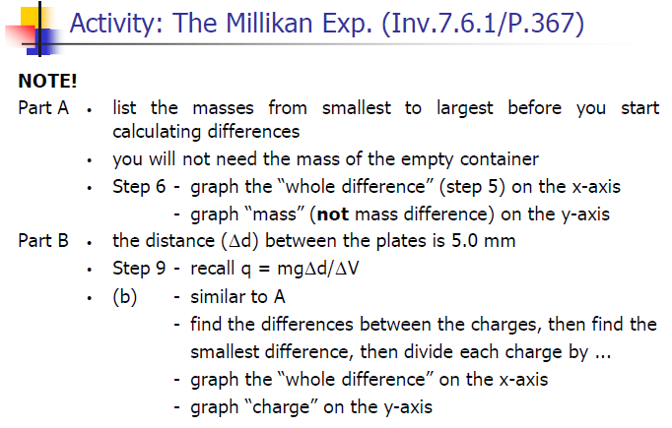

Slide 28
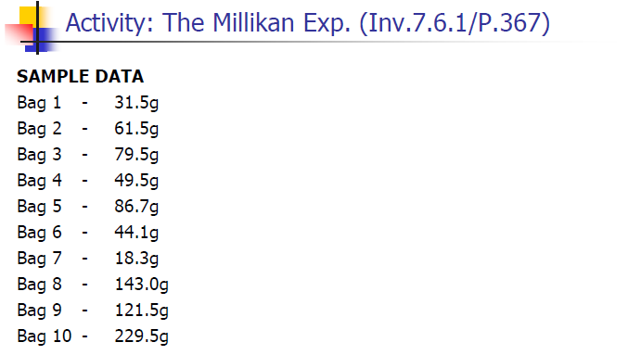

Slide 29
Classwork & Homework

