Slide 1
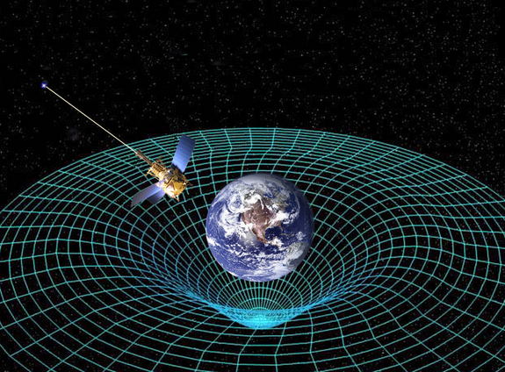
Ch12: Quantum Mechanics
12.3 – Wave Properties of Classical Particles
(pg. 632-639)

Slide 6
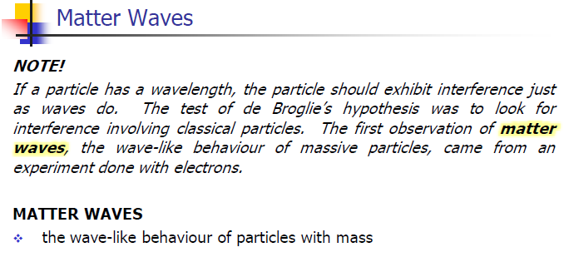

Slide 22
Classwork & Homework

