Slide 1
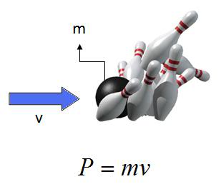
Ch5: Momentum & Collisions
5.3 – Collisions (pg. 233-234)

Slide 11
Classwork & Homework

