Slide 1
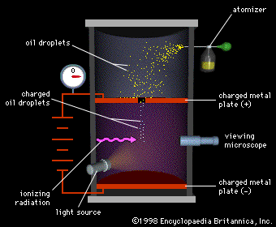
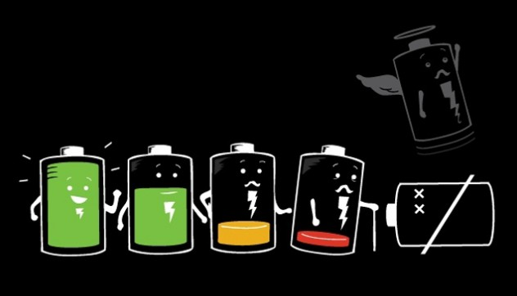
Ch7: Electric Fields
7.4 – Potential Difference and Electric Potential (pg. 350-354)

Slide 15
Classwork & Homework

