Slide 1
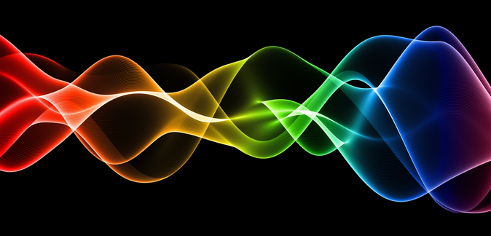
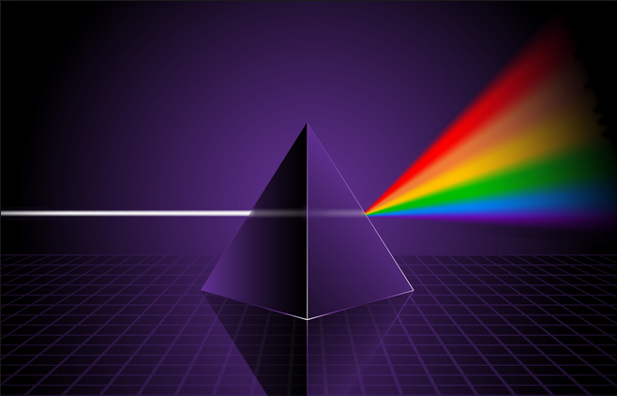
Ch10: Application of the Wave Nature of Light
10.3 – The Diffraction Grating (pg. 520-525)

Slide 9
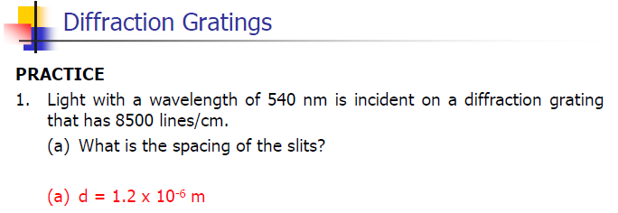

Slide 11
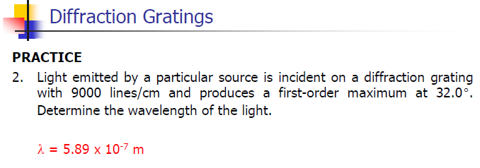

Slide 20
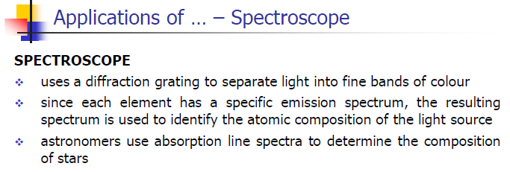

Slide 23
Classwork & Homework

