Slide 1
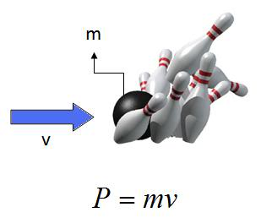
Ch5: Momentum & Collisions
5.2 – Conservation of Momentum in
One Dimension (pg. 228-232)

Slide 15
Classwork & Homework

