Slide 1
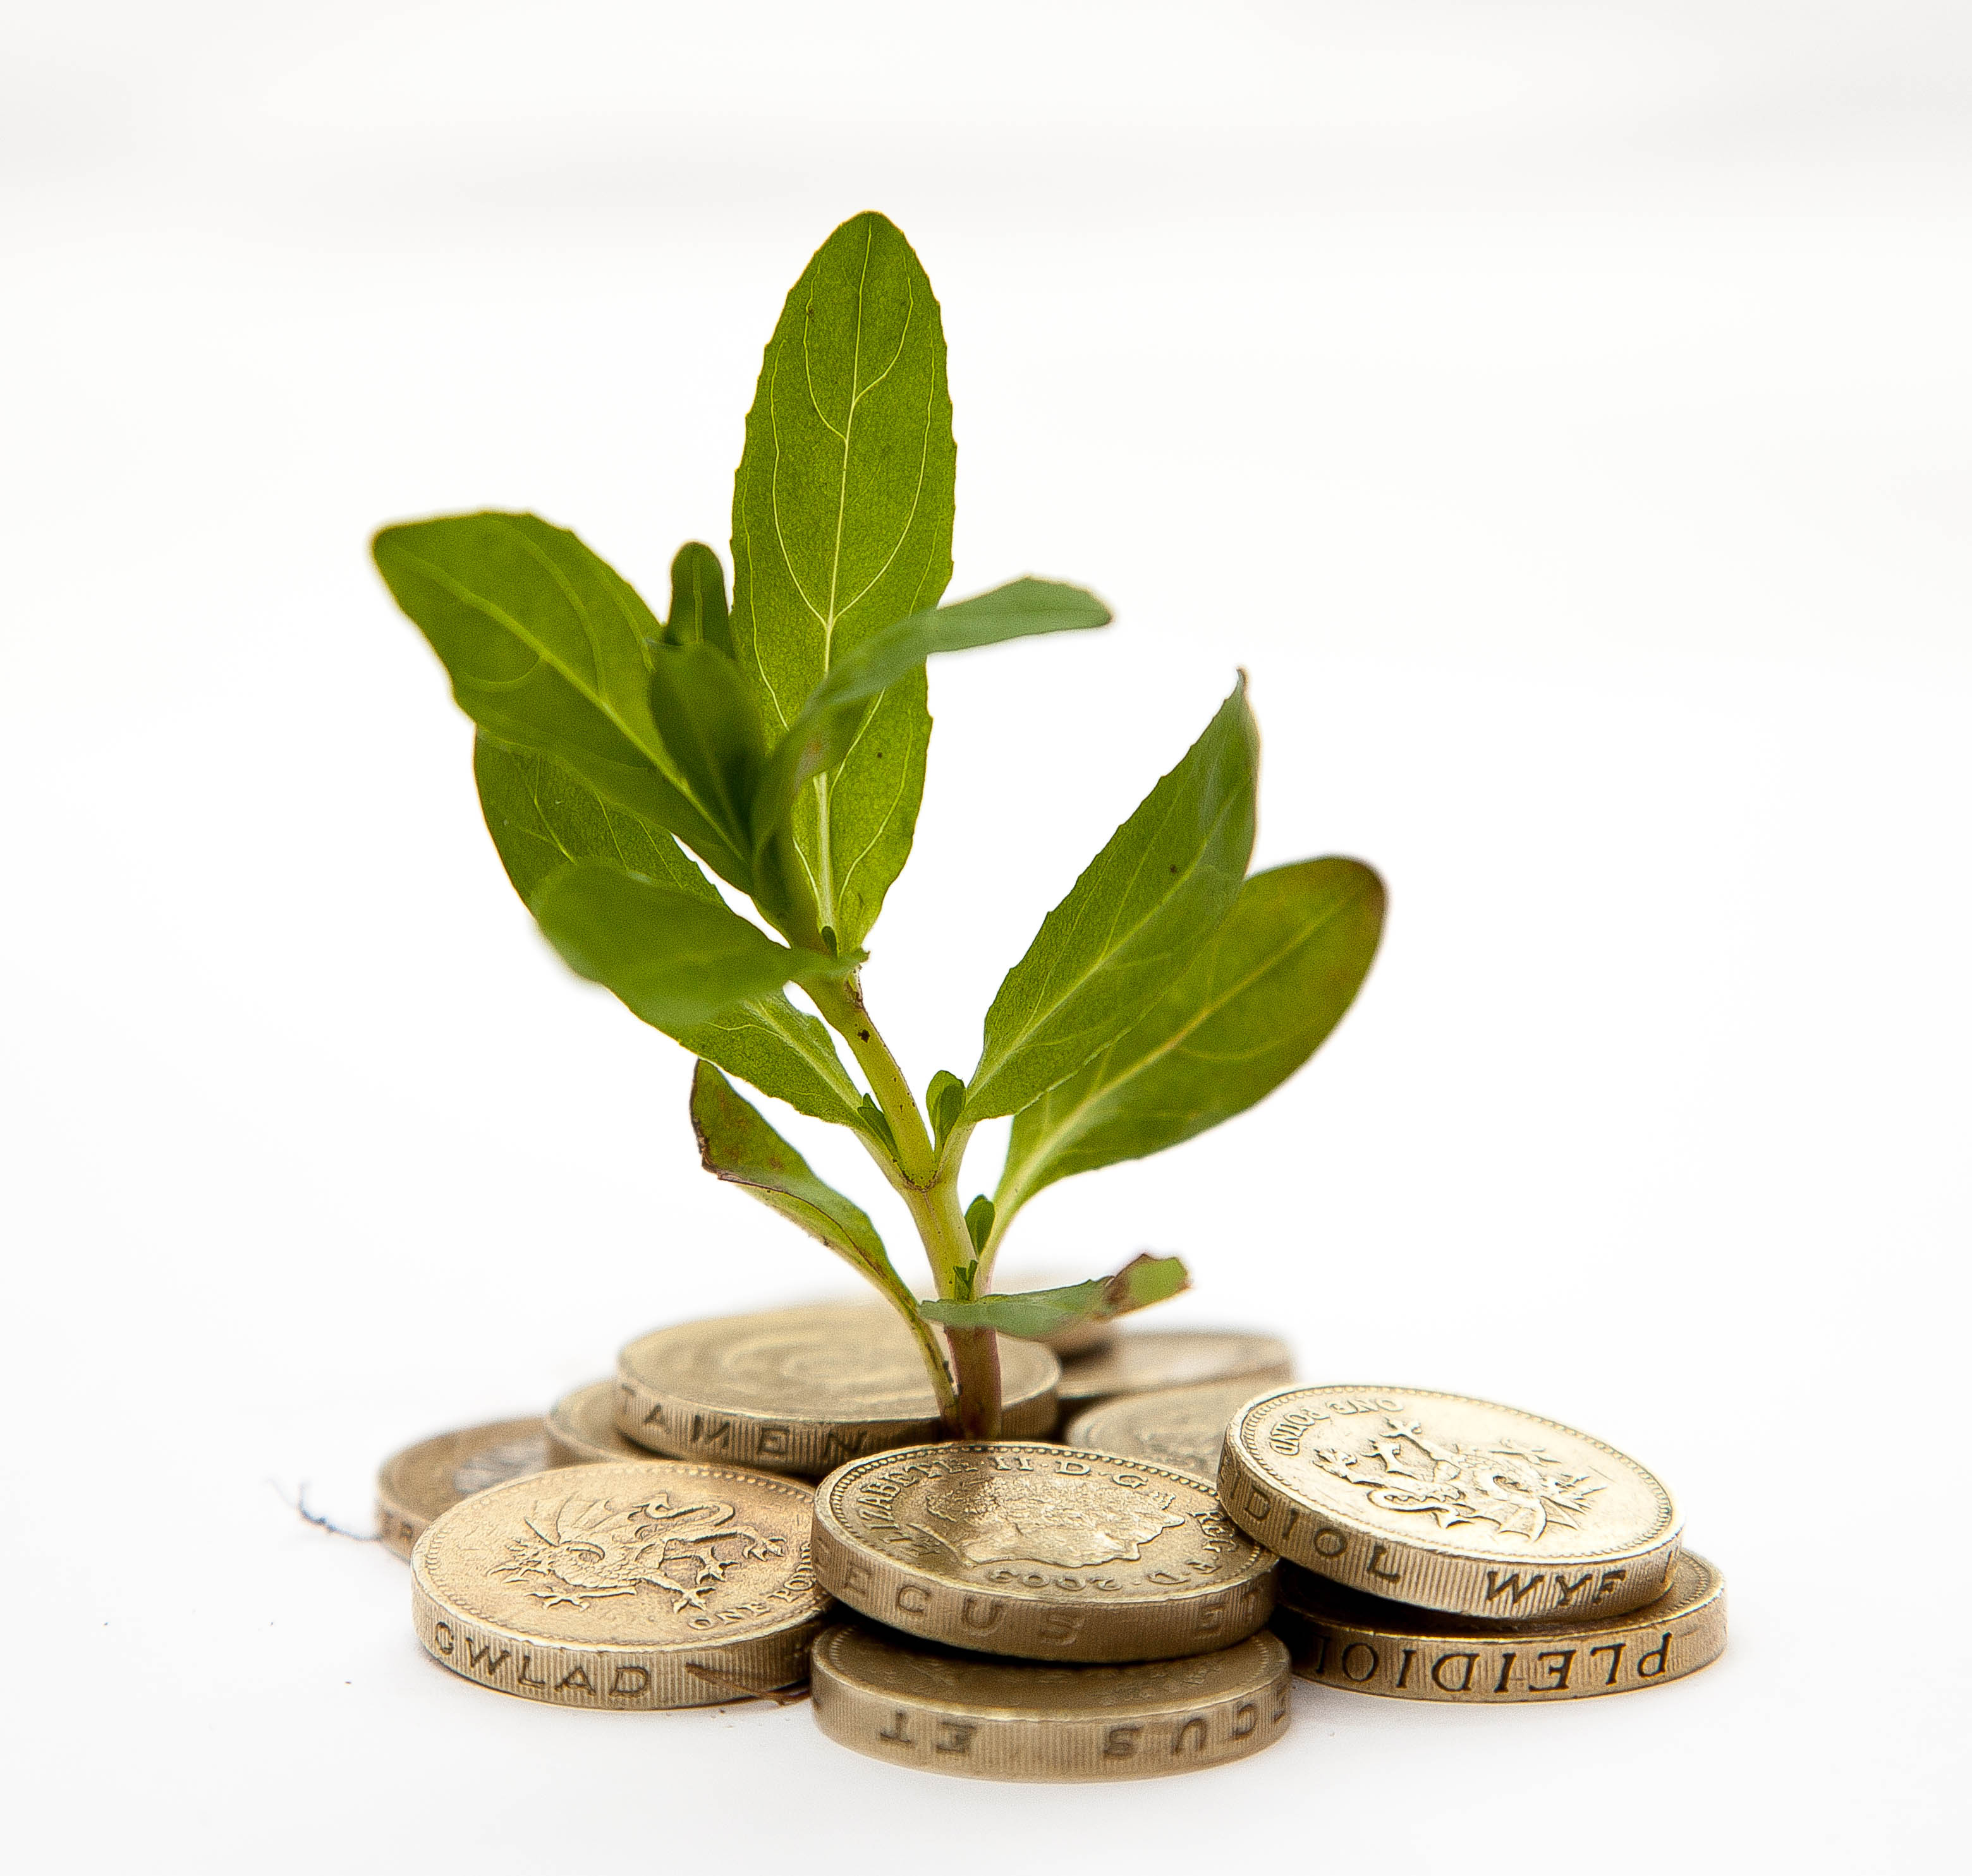
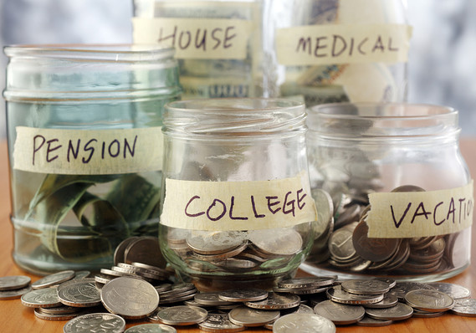
Savings & Interest

Slide 2
Learning Goals
I will be able calculate simple interest and compound interest
I will be able to identify and explain the various savings products available.

Slide 3
Agenda
Minds On
Interest – How does my money grow?
Interest activity – Pairs
Why save?
Exit card

Slide 4
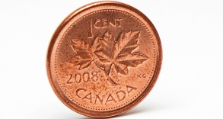
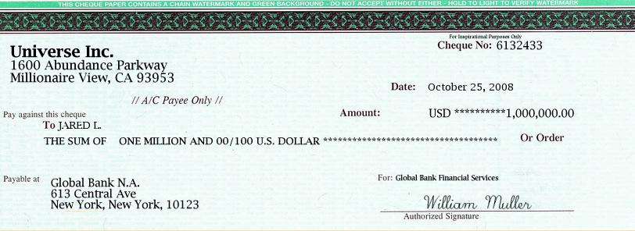
Would You Rather?

Slide 5
Would you rather have:
A cheque for $1 million
A penny that doubles every day for 30 days

Slide 6
Day 1
$0.01
or
$1 000 000.00 cheque

Slide 7
Day 2
$0.02
or
$1 000 000.00 cheque

Slide 8
Day 3
$0.04
or
$1 000 000.00 cheque

Slide 9
Day 4
$0.08
or
$1 000 000.00 cheque

Slide 10
Day 5
$0.16
or
$1 000 000.00 cheque

Slide 11
Day 6
$0.32
or
$1 000 000.00 cheque

Slide 12
Day 7
$0.64
or
$1 000 000.00 cheque

Slide 13
Day 8
$1.28
or
$1 000 000.00 cheque

Slide 14
Day 9
$2.56
or
$1 000 000.00 cheque

Slide 15
Day 10
$5.12
or
$1 000 000.00 cheque
Does anyone want to change their choice?

Slide 16
Day 11
$10.24
or
$1 000 000.00 cheque

Slide 17
Day 12
$20.48
or
$1 000 000.00 cheque

Slide 18
Day 13
$40.96
or
$1 000 000.00 cheque

Slide 19
Day 14
$81.92
or
$1 000 000.00 cheque

Slide 20
Day 15
$163.84
or
$1 000 000.00 cheque

Slide 21
Day 16
$327.68
or
$1 000 000.00 cheque

Slide 22
Day 17
$655.36
or
$1 000 000.00 cheque

Slide 23
Day 18
$1310.72
or
$1 000 000.00 cheque

Slide 24
Day 19
$2621.44
or
$1 000 000.00 cheque

Slide 25
Day 20
$5242.88
or
$1 000 000.00 cheque
Anyone want to change?
Are you sure?

Slide 26
Day 21
$10 458.76
or
$1 000 000.00 cheque

Slide 27
Day 22
$20 971.52
or
$1 000 000.00 cheque

Slide 28
Day 23
$41 943.04
or
$1 000 000.00 cheque

Slide 29
Day 24
$83 886.08
or
$1 000 000.00 cheque

Slide 30
Day 25
$167 772.16
or
$1 000 000.00 cheque

Slide 31
Day 26
$335 544.32

Slide 32
Day 27
$671 088.64
or
$1 000 000.00 cheque

Slide 33
Day 28
$1 342 177.28
or
$1 000 000.00 cheque

Slide 34
Day 29
$2 684 354.56
or
$1 000 000.00 cheque

Slide 35
Day 29
$2 684 354.56
or
$1 000 000.00 cheque

Slide 36
Day 30
$5 368 709.12
or
$1 000 000.00 cheque

Slide 37
There must be an easier way to calculate compound interest.
A = P (1 + i) ^{n}
Amount = 0.01 (1 + 1.0)²⁹
= 0.01 (2)²⁹
= 0.01 (536,870,912)
= $ 5,368,709.12
Here are all of the steps to get the answer, which has the penny doubling 29 times.

Slide 38
Simple vs. Compound Interest Explained
https://www.youtube.com/watch?v=wf91rEGw88Q

Slide 39
Simple Interest
How to Calculate Simple Interest
I (interest) = P (principal) x R (interest rate) x T (time)
Financial institutions do not calculate using this simple formula. Take into account amounts repaid during the loan:
charge interest only on the amount outstanding.

Slide 40
Simple Interest
How to Calculate Simple Interest
I (interest) = P (principal) x R (interest rate) x T (time)
If you put $10,000 into a saving account at 5% for 5 years, what will the interest amount be for both?
I = $10,000 x 0.05 x 5
I = $2,500

Slide 41
Compound Interest
How to Calculate Compound Interest
A (principal +interest) = P (1 + i)
If you put $10,000 into a saving account at 5% for 5 years, what will the interest amount be for both?
A = $10,000 (1 + 0.05)
A = $12,762
Therefore total interest gained $2,762
n
5

Slide 42
Simple VS Compound Interest
Complete the “try this” exercise on your worksheet.
Simple | Compound
I = $5,000 x 0.08 x 30 I = $12,000 | A = $5,000 (1 + 0.08) A = $50,313 Interest = $45,313
30

Slide 43
Interest Activity
In pairs, discuss and complete the simple and compound interest questions (1-3).
Let’s review the answers.

Slide 44
3 Muskateers
In groups of three, provide examples/descriptions for each one of the three reasons why people save.
Need for Saving
Need for Saving | Description
Emergency Needs
Short and long term goals
Security and future needs

Slide 45
Would you rather have:
Need for Saving | Description
Emergency Needs | Help pay for unexpected expenses Just lost your job and need to cover expenses NOTE: Financial planners state you should have 3-6 months’ salary in a savings account
Short and long term goals | Purchase of inexpensive items in a short period (concert tickets, a bike, a new TV) Saving for a longer period of time to save for more expensive items (house, car)
Security and future needs | Knowing you have money for unexpected emergencies Have extra income for retirement

Slide 46
Shannae needs help!!!
Even though she has a budget, she always forgets it. She has no savings and is living pay cheque to pay cheque. Her kids are worried that their mom won’t be able to afford her life when she retires.
What advice could you give her about saving?

Slide 47
Types of Investments/Savings
Savings Account GICs
RRSPs RESP
Canada Savings Bonds Mutual Funds

Slide 48
Group Activity Investments/Savings
In groups of 2/3:
Go to a financial institution website
You will obtain information regarding investment products from the institution’s website
What is the product? (definition)
Based on the product facts, what are the advantages and disadvantages (discuss)

