Slide 1
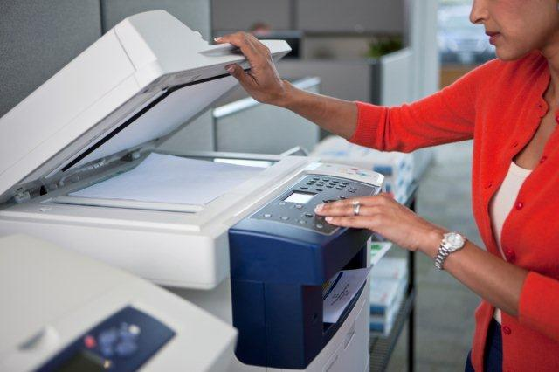
The functions of a photocopier
By Swetha and Claire and supervision by Sena and Julia

Slide 2
What is a photocopier?
A photocopier is an electronic machine that makes copies of images and documents.

Slide 3
What is inside a photocopier?
Photoreceptor drum or belt
Corona wires
Lamp and lenses
Toner
Fuser

Slide 4
How does a photocopier work?

Slide 5
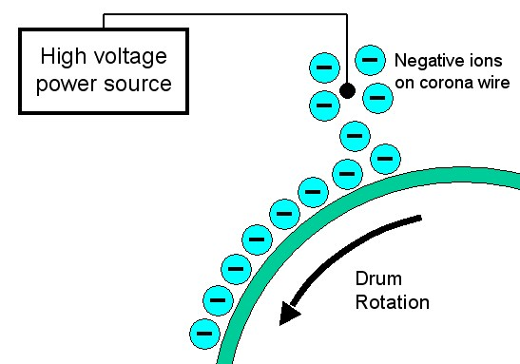
How it works
Most photocopiers use a technology called Xerography. Which is a process that uses electrostatic charges on a light-sensitive photoreceptor to attract then transfer toner (ink) particles onto the paper into the form of an image.

Slide 6
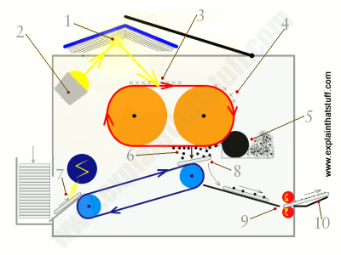
Step #1
The original page goes inside the scanner. An extremely bright light scans the entire document. More light reflects off the white areas (where there is no ink) than off the black areas (where there is ink).

Slide 7
Step #2
A "shadow" of the page is created on a rotating conveyor belt called a “photoconductor” . The belt rotates while bringing the “shadow” with it. The tiny particles of powder called toner touches the belt.

Slide 8
Step #3
The electrically charged toner gets stuck to the “shadow” and creates an image using ink on the original page. Another page comes up from the other side of the copier and slides up from another conveyer belt. This page moves along and is given a strong electric charge which attracts the toner from the original to the second page.

Slide 9
Step #4
The copied page passes through two hot rollers. This is called a fused unit where the toner particles on the page are fused onto the paper permanently. The copy comes out from the other end of the copier (still warm from the fuser unit) and may still have wet ink before it completely dries. ( DON’T TOUCH IT TILL IT DRIES)

Slide 10
Citation
How Photocopiers Work. (2001, February 01). Retrieved March 26, 2017, from http://home.howstuffworks.com/photocopier1.htm
Woodford, C. (2016, August 03). How does a photocopier work. Retrieved March 26, 2017, from http://www.explainthatstuff.com/photocopier.html

