Slide 1
Experiential learning By yours truly: Mr. Panchbhaya
LEARNING THEORIES GROUP PRESENTATIONS

Slide 2
1. Introduction
Field Trip to the Zoo:
http://www.youtube.com/watch?v=nfXzHcCpR5Y
The great Greek Philosopher Aristotle said, "The things we have to learn before we do them, we learn by doing them."

Slide 3
2. Activity to Demonstrate Principles of Experiential Learning
What activity do you guys want to do?
Play dough
Trip to the library
Blackjack with cards
Notes:
Play dough provides enjoyable and satisfying experiences (not merely fun), but provides hands-on, active learning experiences, supporting child growth and learning in many domains

Slide 4
3. Principle Ideas of Experiential Learning
Process of learning from experience
Emphasis is on the process of learning and not on the product
Can apply the knowledge in practice settings
Steps are done in the same manner in which a toddler learns to walk, children learn to ride a bike/skate, or learning that fire is dangerous by experiencing immense pain
Learning occurs in social, emotional, language, physical, and cognitive domains

Slide 5
David Kolb on Experiential Learning
http://goanimate.com/videos/0lRpn-wVltoM
Experience
Observation and Reflection
Formation of abstract concepts
Testing in new situations
This concept should be approached as a continuous spiral

Slide 6
Experiencing/Engage
(the activity phase)
Sharing
(sharing reactions and observations)
Analyzing or processing (patterns or dynamics are determined)
Inferring or generalizing (principles are derived)
Applying (plans made to use learning in new situations)

Slide 7
4. How Experiential Learning can be Applied Effectively in the Classroom
It can be applied through training
Learning can be best achieved through the combination of effort, determination, and involvement
Cooperation and communication are key
Rather than merely thinking about the encounter, or only considering the possibility of doing something about it, you use hands-on approaches to target the task
It is more skill development versus simply acquiring knowledge and concepts

Slide 8
5. Applying Experiential Learning to Your Own Teaching – “Theory in Practice”
Students will acquire through training and experience:
knowledge
essential skills
work habits
Leads to new innovations and start-up companies into market-ready products and services

Slide 9
Where you may see experiential learning outside of the classroom
Volunteer work
Co-op and Internships to explore career choices
Placement
Community-based projects
Service-learning projects abroad
Research projects (thesis)

Slide 10
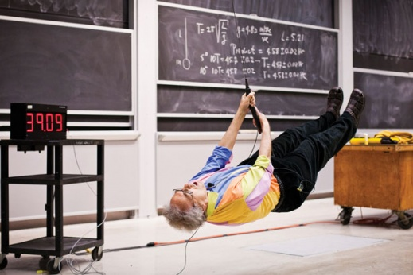
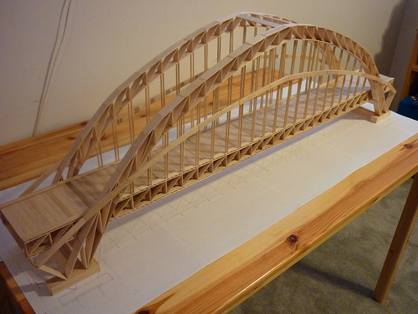
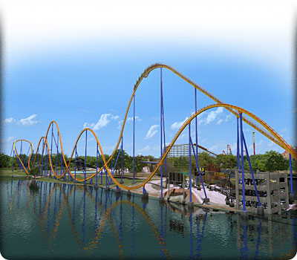
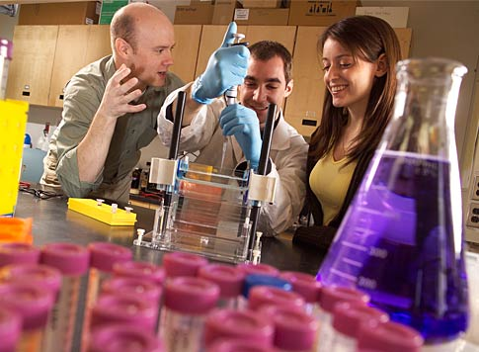

Slide 11
Experiential Learning
IN THE CLASSROOM
ONLINE
Wet labs
Hands-on projects
Field trips
Games
Role playing
Conducting experiments
Model building
Photography, video, art
Mock Interviews
Cooperative education
Practical experiences
Hands-on Laboratory Activities
Virtual labs
Simulations
Virtual field trips
Online games
Web quests

Slide 12
6. Benefits and Drawbacks of Experiential Learning (fill in the chart)
Benefits
Cautions/Disadvantages
Notes:
Benefits: foster personal growth, increase knowledge, promote engagement and networking, cross-cultural exposure and learning, exploration of the world, development of life skills, clarify values
Disadvantages: negative experiences/emotions can sometimes hinder learning, inexperienced people, too much entertainment loss of focus in learning, learning outcomes are not predictable, neglect of some stages can prove to be major obstacles to learning, “locked into” one style can put a learner at a serious disadvantage

Slide 13
7. Summary
One of the most important goals for a student is to gain employment upon graduation
As teachers, we should place particular emphasis on how well students can apply knowledge in practice settings
As instructors, we have to organize and facilitate direct experiences that will lead to genuine, meaningful, and long lasting learning
The student will then become more actively involved in the learning process
Learned knowledge can only be useful only when you put them into actual practice
Experience is like a catalyst that boosts learning process

Slide 14
THE END
Tell me and I will forget
Show me and I may remember
Involve me, and I will understand

