Slide 1
9.5 & 9.6 Optimization cylinders surface area & volume

Slide 2
Agenda
Take up Homework Questions
Warm Up
Lesson on Optimization of Cylinders
Worksheets/Homework

Slide 3
Learning Goals
Determine the minimum surface area for a given volume
Solve problems involving maximizing the volume

Slide 5
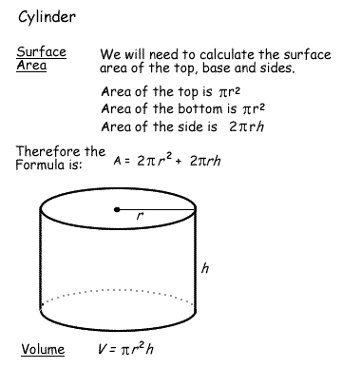
Volume and Surface Area of a Cylinder

Slide 6
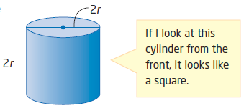
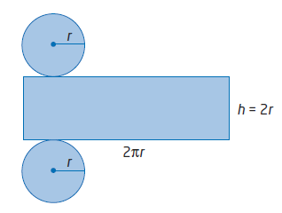
To maximize the volume
The maximum volume for a given surface area of a cylinder occurs when its height equals its _________. That is, ___________ or _________
The dimensions of the cylinder with maximum volume for a given surface area can be found by solving the formula:
and the height will be ________ that value, or _________

Slide 7
Substitute h = 2r into the formula for surface area of a cylinder to solve for the SA formula above:

Slide 8
Rearrange the formula to solve for height:

Slide 9
1. a. Find the dimensions of a cylinder with maximum volume that can be made with 600cm² of aluminum. Round the dimensions to the nearest hundredth of a centimetre.

Slide 10
1. b. What is the volume of this cylinder, to the nearest cubic centimetre?

Slide 11
Minimize Surface Area of a Cylinder
The minimum surface area for a given volume of a cylinder occurs when its height equals its ____________. That is, ___________ or ____________
The dimensions of the cylinder of minimum surface area for a given volume can be found by solving the formula:
and the height will be ________ that value, or _________

Slide 12
Substitute h = 2r into the formula to solve for the V formula above:

Slide 13
2 a. Determine the least amount of aluminum required to construct a cylindrical can with a 1 litre capacity, to the nearest square centimetre.

Slide 14
2 b. Describe any assumptions made.

Slide 15
Homework
Pg. 508 # 1ac, 2, 3, 4, 8
Pg. 513 # 1ac, 2, 3, 4, 5, 6
UNIT Test Wednesday on Chapter 8 and Chapter 9 (all sections)

Slide 16
The hardest class Mr. Z has taught yet
It was definitely an honour teaching you Grade 9’s. Every moment was a cherished memory whether it be from my favourite class saying “OooOo Clickers” or “Mr. Z, my god how many mistakes do you have on your worksheet” LOL.
We’ve accomplished nearly 5 chapters in the 6 weeks I have been here, and all of you deserve a pat on the back.
I wish you the best of luck in the future years to come, and I know for a fact that you will succeed throughout school

