Slide 1
CH 9: Wave Interactions CH 10: Applications of Waves
9.4 – Damping and Resonance
10.4 – Structural Safety
10.6 – Vibrations in Aircrafts

Slide 13
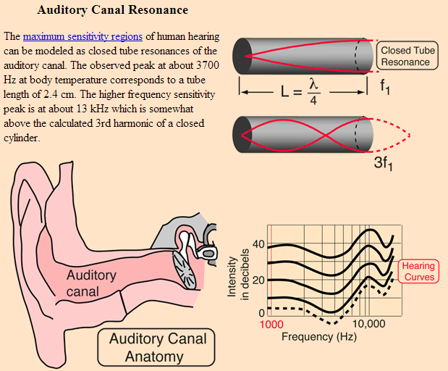

Slide 18
Bartons Pendulum
Harvard Pendulum Waves
http://www.youtube.com/watch?v=yVkdfJ9PkRQ
Glow in the dark
http://www.youtube.com/watch?v=7_AiV12XBbI

Slide 20
Resonance (Wine Glass in Slow Motion)
http://www.youtube.com/watch?v=JDnNmLkQ3Bc (prof)
http://www.youtube.com/watch?v=BE827gwnnk4 (slow mo)

Slide 21
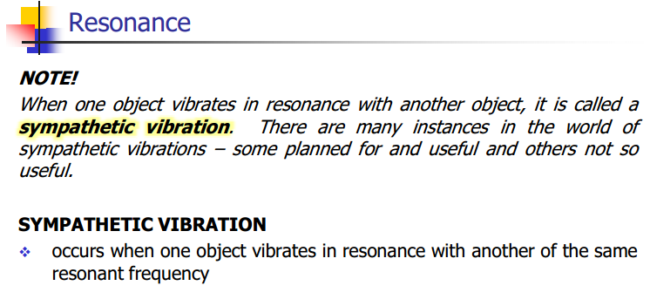

Slide 26
Resonance (Tacoma Narrows Bridge)
http://www.youtube.com/watch?v=6ai2QFxStxo

Slide 27
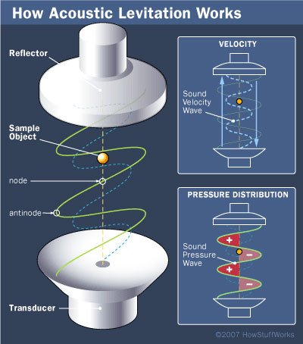
Acoustic Levitation
http://www.youtube.com/watch?v=Ah2X0F0nBfQ

Slide 28
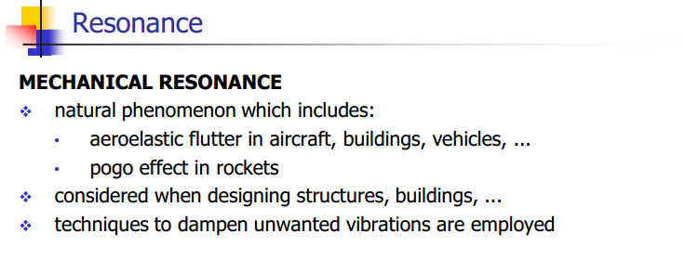

Slide 31
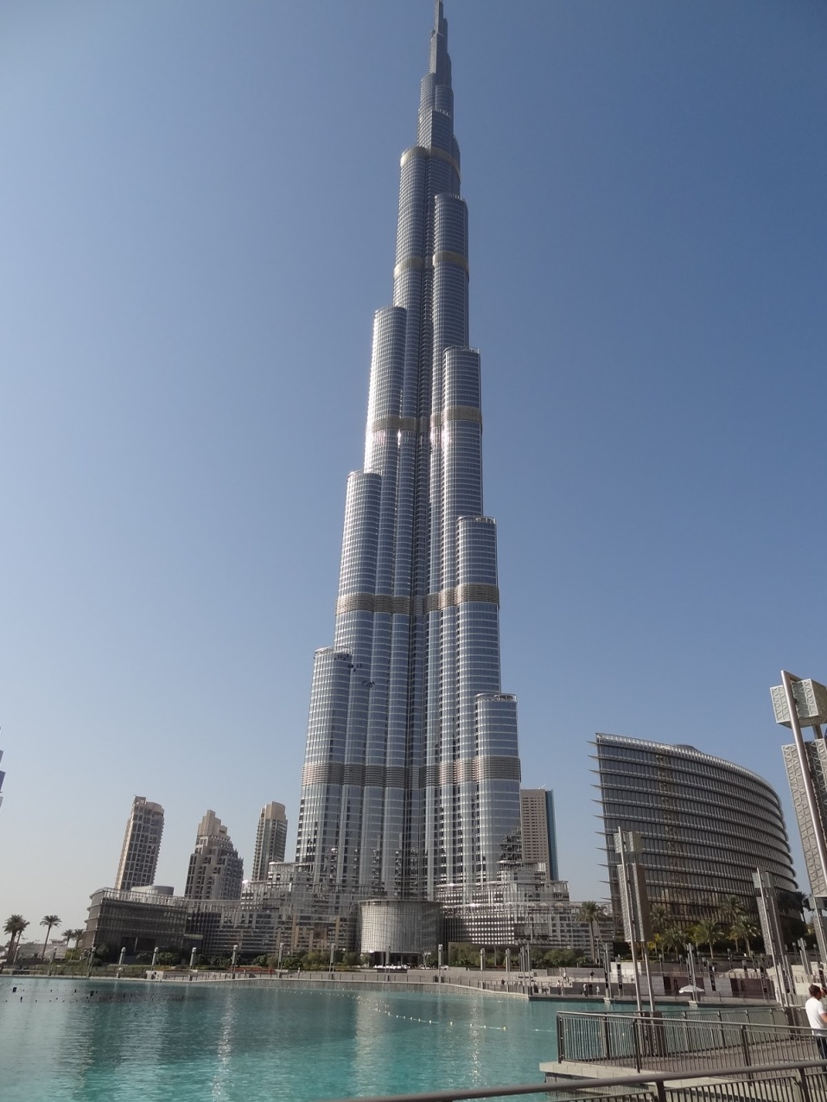
Vibrations in Buildings

Slide 32
Classwork & Homework

