Slide 1
CH 9: Wave Interactions
9.2 – Waves at Media Boundaries

Slide 2
Agenda
Section 9.2
Homework problems

Slide 6
Standing Waves
http://www.youtube.com/watch?v=3BN5-JSsu_4
Glow in the dark
http://www.youtube.com/watch?v=j_z88-vvz48

Slide 11
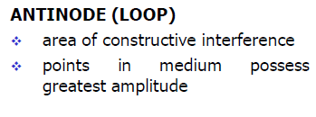

Slide 12
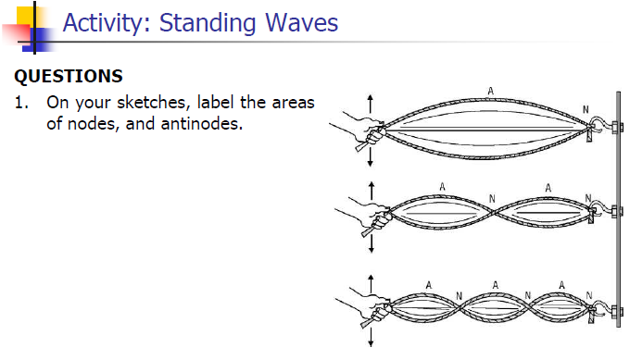

Slide 15
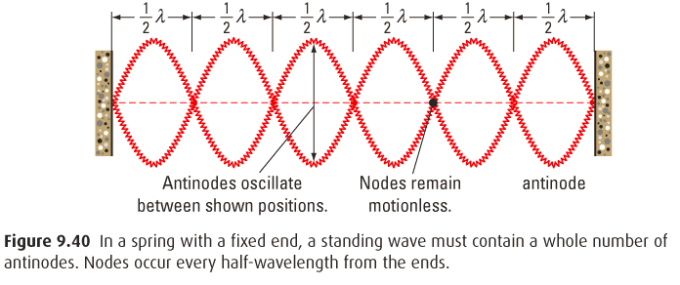
Nodes and Antinode

Slide 18
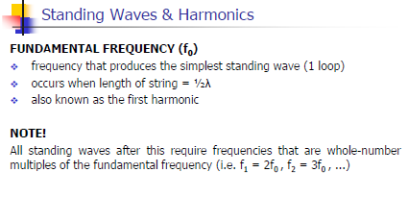

Slide 19
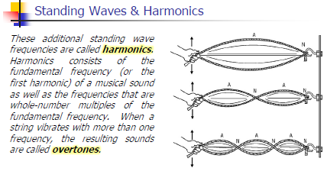

Slide 21
Classwork & Homework
Pg. 426 (#1-8)

