Slide 1
CH 9: Wave Interactions
9.2 – Waves at Media Boundaries

Slide 2
Standing Waves
http://www.youtube.com/watch?v=3BN5-JSsu_4
Glow in the dark
http://www.youtube.com/watch?v=j_z88-vvz48

Slide 7
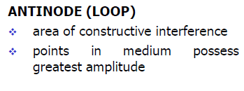

Slide 8
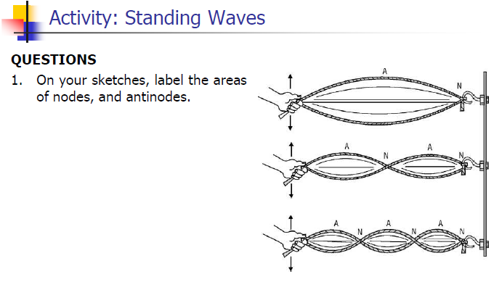

Slide 12
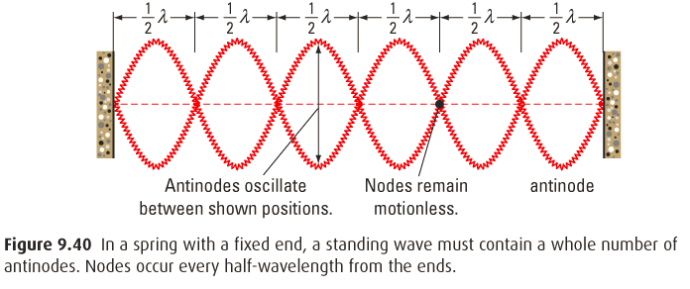
Nodes and Antinode

Slide 13
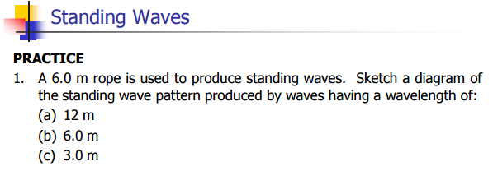

Slide 20
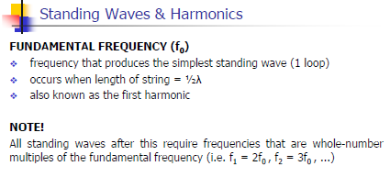

Slide 21
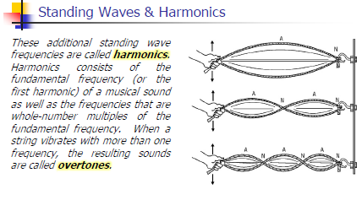

Slide 23
Classwork & Homework
Pg. 426 (#1-8)

