Slide 1
CH 9: Wave Interactions
9.1 – Interference of Waves

Slide 9
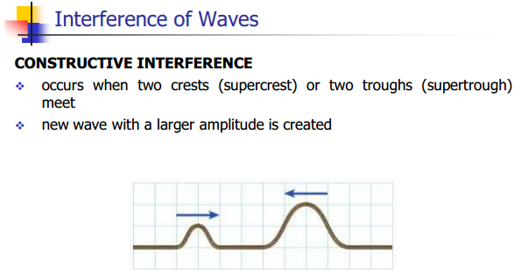

Slide 12
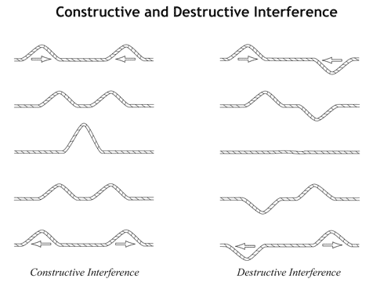
http://www.youtube.com/watch?v=qvtCN9g9aEE

Slide 19
Classwork & Homework

