Slide 1
CH 8: Vibrations and Waves
8.5 – Properties of Sound Waves

Slide 2
Agenda
Quiz
Section 8.5
Homework problems

Slide 7
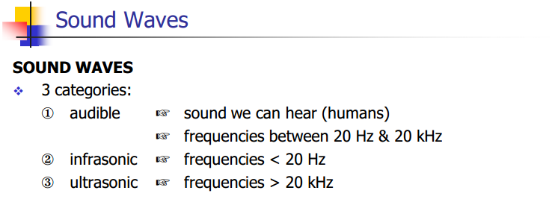

Slide 12
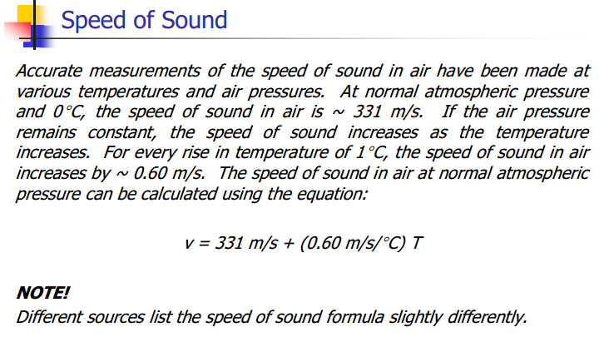

Slide 13
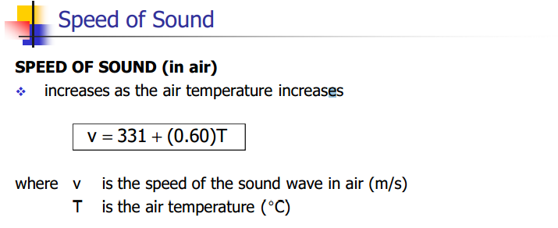

Slide 18
Mach Number

Slide 19
Breaking the speed of sound (shockwave and sonic boom)
http://www.youtube.com/watch?v=6o0zmafxTmE

Slide 20
Sound Intensity

Slide 21
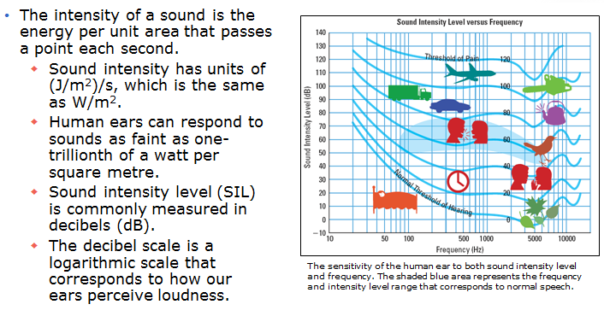
Intensity and the Decibel Scale

Slide 22
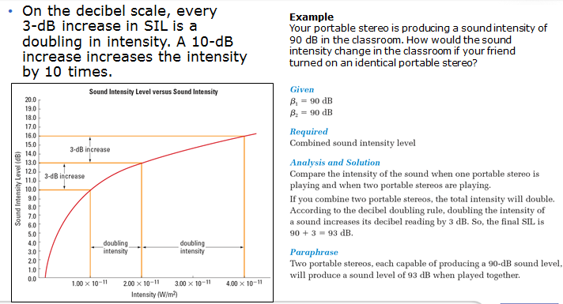
Intensity and the Decibel Scale

Slide 23
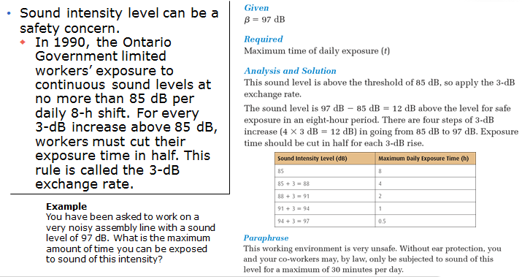
Noise, Music, and Hearing Loss

Slide 24
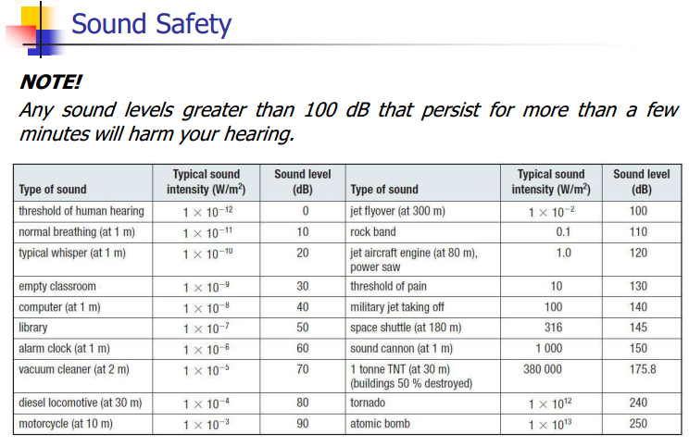

Slide 25
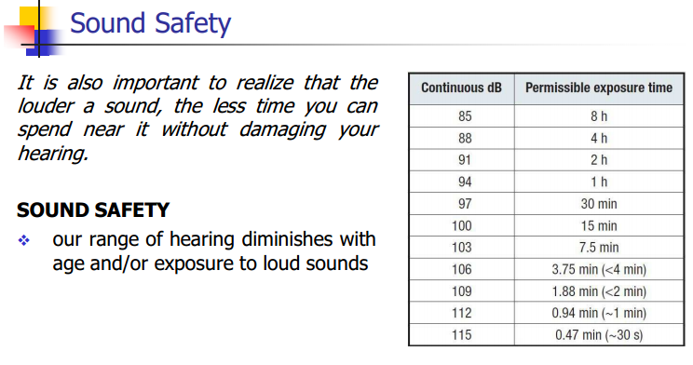

Slide 26
Classwork & Homework
Pg. 397 (#1-11)

