Slide 1
CH 8: Vibrations and Waves
8.5 – Properties of Sound Waves

Slide 5
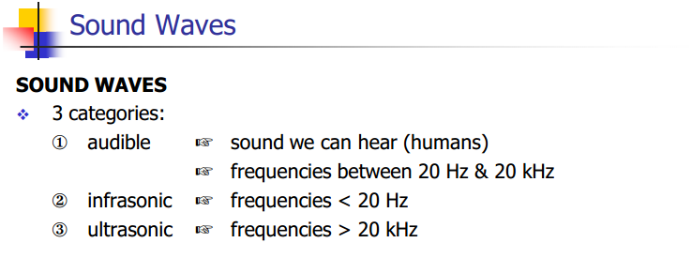

Slide 10
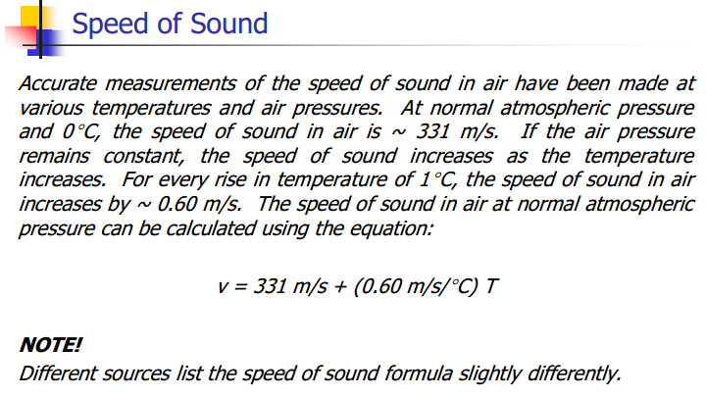

Slide 11
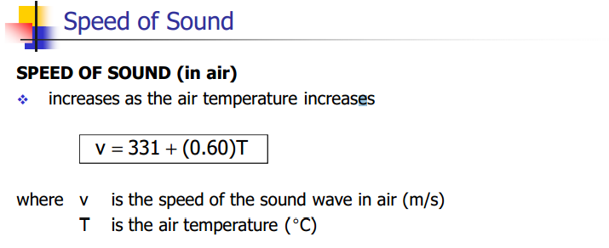

Slide 15
Mach Number

Slide 16
Sound Intensity

Slide 17
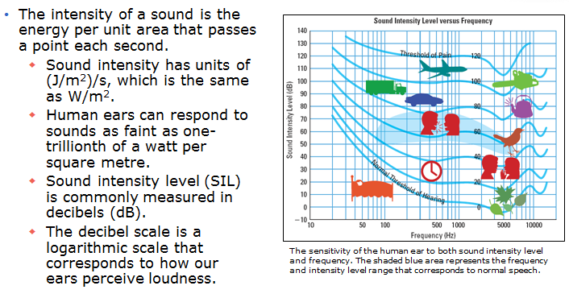
Intensity and the Decibel Scale

Slide 18
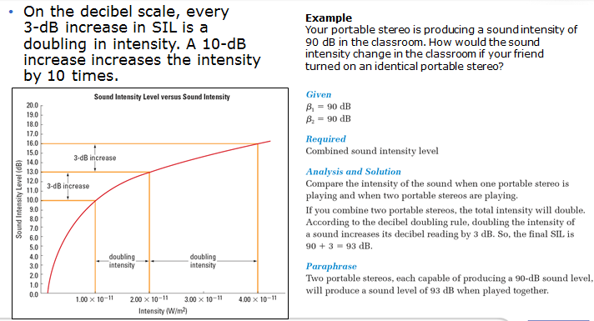
Intensity and the Decibel Scale

Slide 19
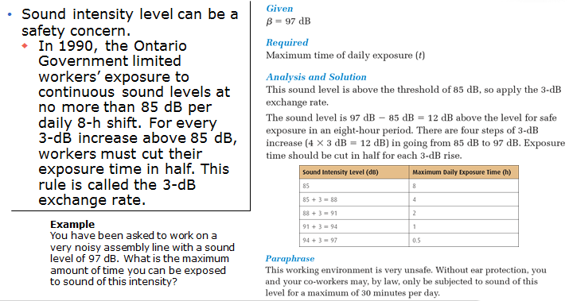
Noise, Music, and Hearing Loss

Slide 20
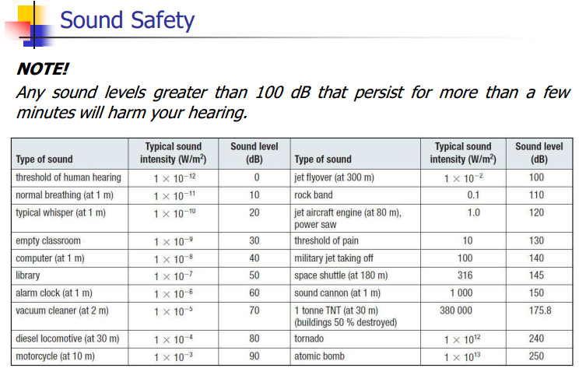

Slide 21
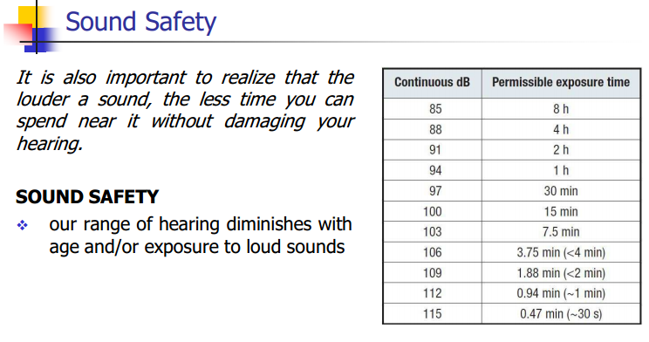

Slide 22
Classwork & Homework

