Slide 1
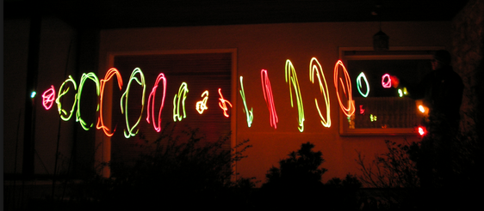
CH 8: Vibrations and Waves
8.4 – Determining Wave Speed

Slide 2
Agenda
Complete Section 8.4
Take up homework problems Section 8.1 to 8.4

Slide 3
Simple Harmonic Motion (SMH)

Slide 8
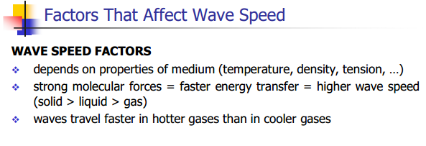

Slide 9
Temperature

Slide 10
Linear Density

Slide 11
Tension

Slide 12
Practice #1 (pg. 391)

Slide 13
Practice #2 (pg. 391)

Slide 14
Practice #3 (pg. 391)

Slide 19
Classwork & Homework
Pg. 384 (#2,7,8)

