Slide 1
CH 8: Vibrations and Waves
8.1 – What is a vibration

Slide 2
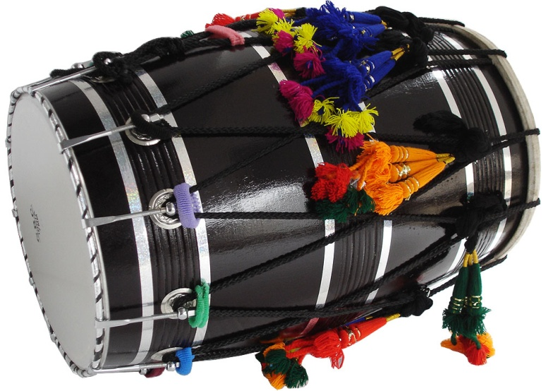
Vibrations & waves

Slide 3
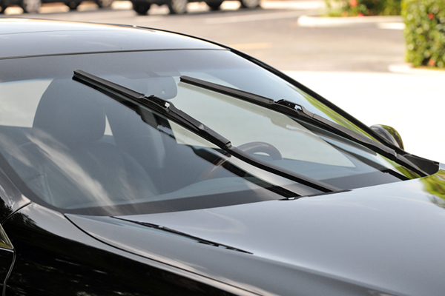
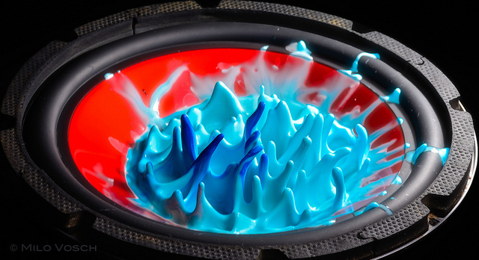
Vibrations

Slide 7
CH 8: Vibrations and Waves
8.2 – Types of Mechanical Waves

Slide 16
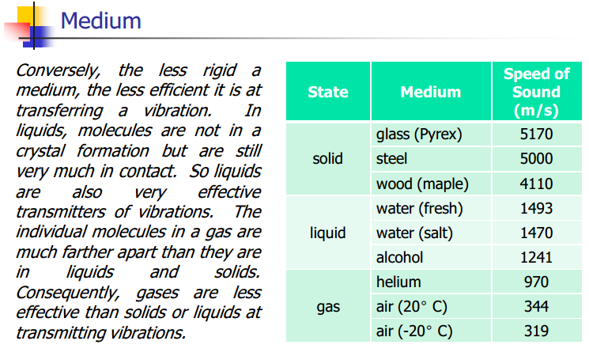

Slide 17
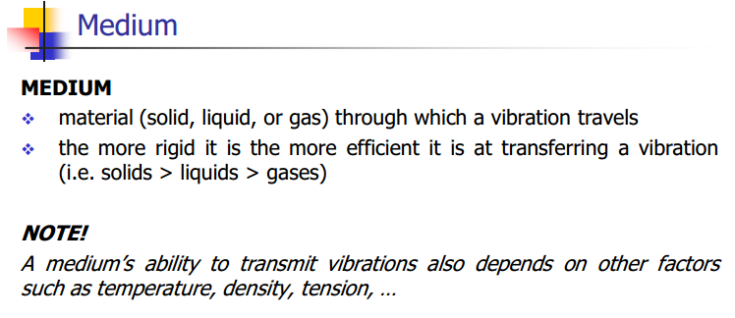

Slide 23
Bill Nye – Sound Travels in Waves:
http://www.youtube.com/watch?v=ACeUO4ufx2I

Slide 24
Transverse waves vs. Longitudinal waves
http://www.youtube.com/watch?v=7cDAYFTXq3E

Slide 36
Classwork & Homework

