Slide 1
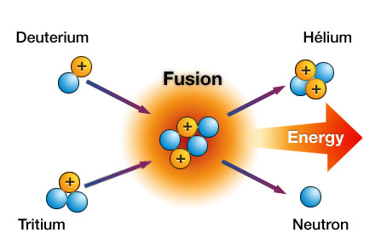
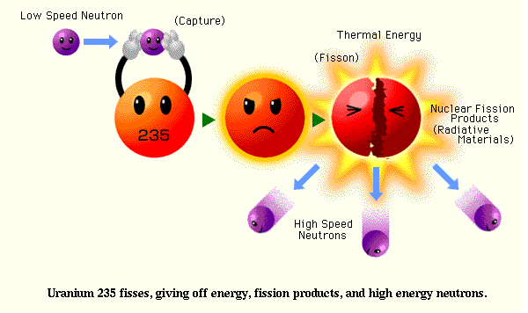
CH 7: Nuclear Energy and Society
7.4 & 7.5 – Nuclear Fission and Fusion

Slide 2
Hydrogen Bomb (Fusion)
http://www.youtube.com/watch?v=qjnm3V0xYjI

Slide 3
Atomic Bomb (Fission)
http://www.youtube.com/watch?v=UTdy1Yp1h5A

Slide 8
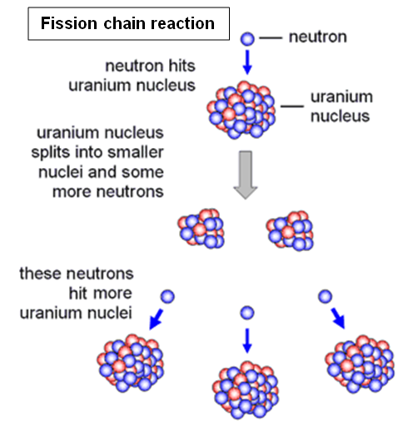

Slide 9
Video
http://www.youtube.com/watch?v=N7C14UIKuv8
Jimmy Kimmel 900 mouse Traps Unleashed
http://www.youtube.com/watch?v=XIvHd76EdQ4

Slide 11
Energy
1 kg of water flowing over Niagara Falls produces about 1 kJ of gravitational potential energy
1 kg of gasoline burns to produce about 4×10⁴ kJ of heat energy
1 kg uranium undergoes fission in a nuclear reactor to produce about 1×10¹¹ kJ of heat energy

Slide 15
Video
http://www.youtube.com/watch?v=Cb8NX3HiS4U

Slide 22
Classwork & Homework

