Slide 9
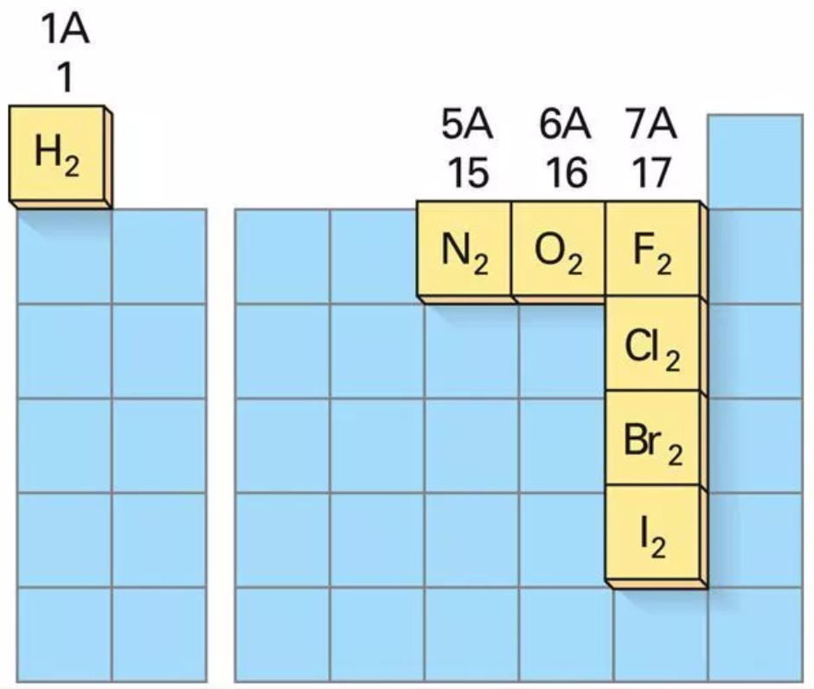

Slide 14
Water (H₂O) | Hydrogen Peroxide(H₂O₂)
Colourless liquid Non-toxic Boils at 100°C Stable in strong sunlight Dissolves the chemical potassium iodide Does not bleach pigments | Blue liquid Can be toxic Boils at 150.2°C Breaks down in light Reacts with the chemical potassium iodide Strong bleaching agent

Slide 17
Homework
This is the practice questions to be completed over the week in order to practice for your test. All solutions can be found on the class website.
7.1 – Putting Atoms Together
pg. 261 # 1 to 6, 8 to 11
7.3 – How Atoms Combine
pg. 266 # 1, 2, 5 to 10

