Slide 1
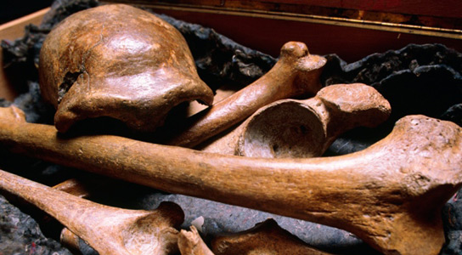
CH 7: Nuclear Energy and Society
7.3 – Half Life (pg. 330 – 333)

Slide 2
Agenda
Section 7.3
Textbook Problems

Slide 13
Half-Life Equation

Slide 14
Practice #1 (pg.332)

Slide 15
Practice #2 (pg.332)

Slide 16
Classwork & Homework
Pg. 333 (#1-5)

