Slide 1
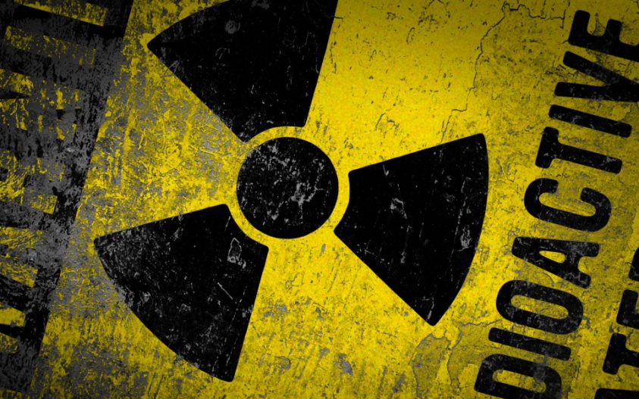
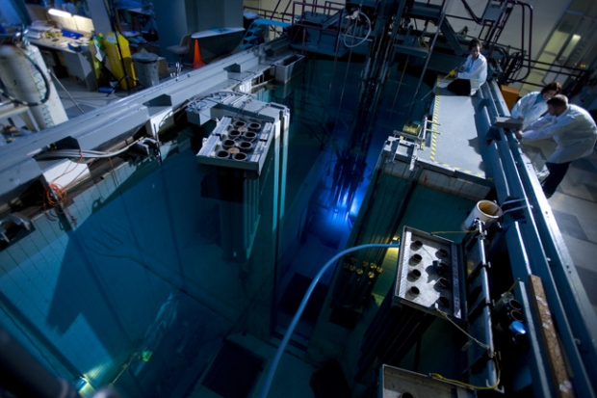
CH 7: Nuclear Energy and Society
7.2 – Radioactive Decay (pg.323-329)

Slide 17
Classwork & Homework

