Slide 1
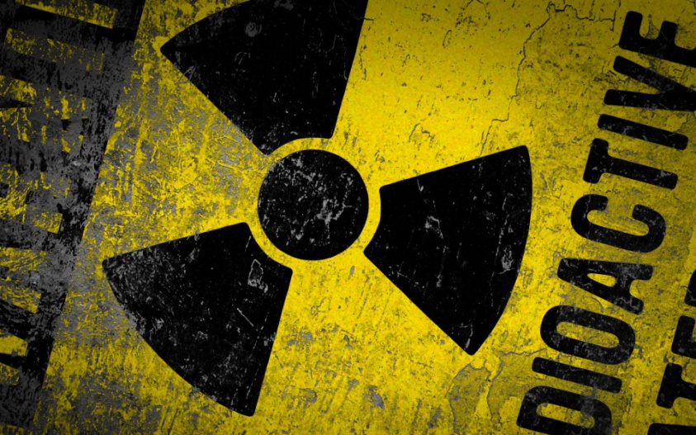
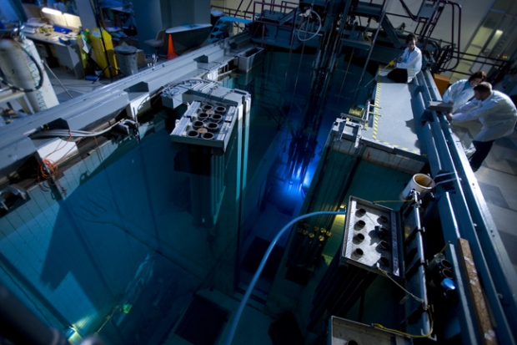
CH 7: Nuclear Energy and Society
7.1 – Atoms & Isotopes (pg.318 -322)

Slide 20
Classwork & Homework

