Slide 1
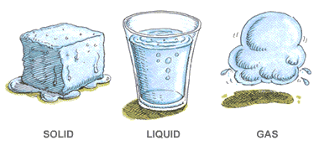
CH 6: Thermal Energy and Society
6.4 – States of Matter and Changes of States(pg. 288-295)

Slide 2
Agenda
Section 6.3
Section 6.4
Textbook Problems

Slide 3
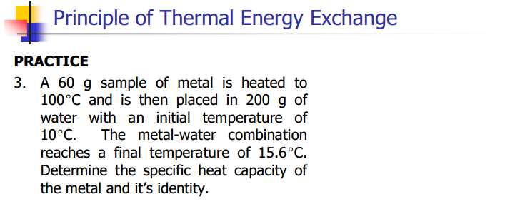

Slide 4
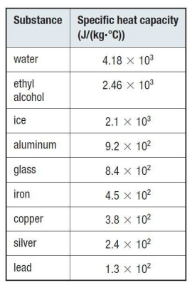

Slide 5
Practice #1 (pg.286)

Slide 7
Practice #2 (pg.286)

Slide 28
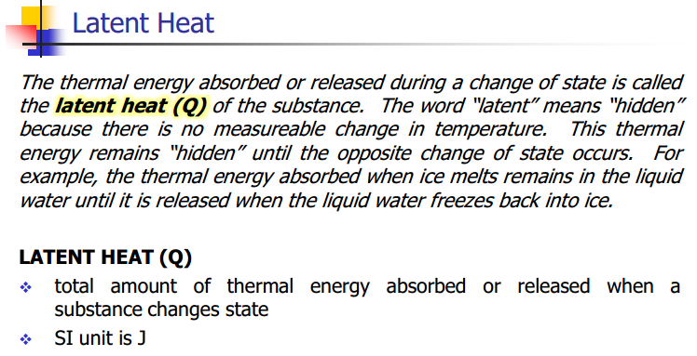

Slide 29
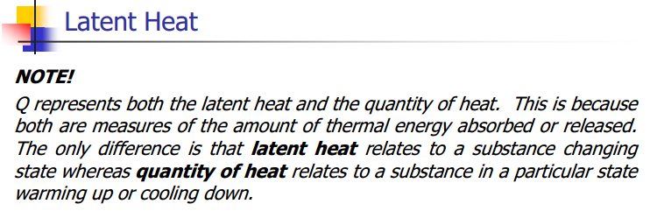

Slide 30
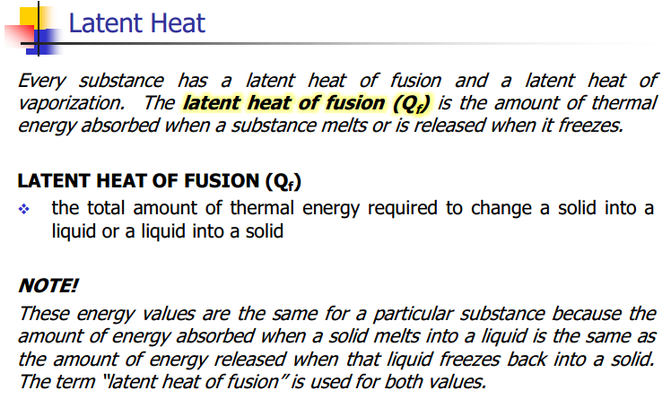

Slide 34
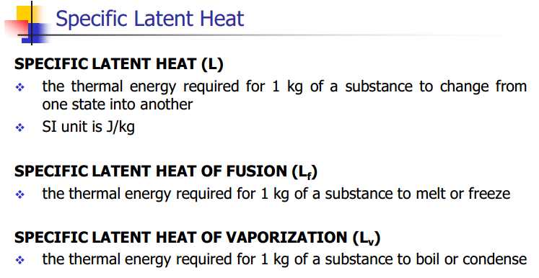

Slide 35
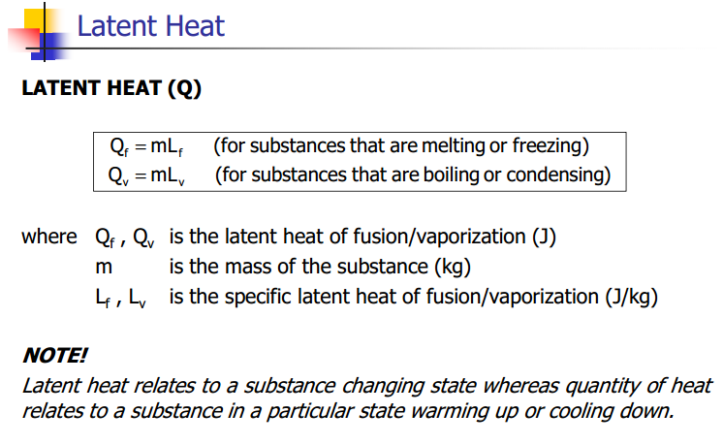

Slide 36
Practice #1 (pg.293)

Slide 37
Practice #2 (pg.293)

Slide 38
Practice #3 (pg.293)

Slide 39
Classwork & Homework
Pg. 287 Questions (#1-10)

