Slide 1
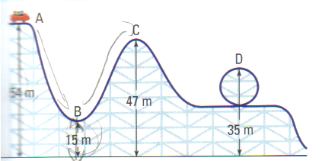
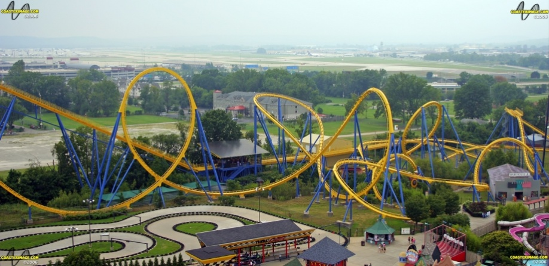
CH 5: Work, Energy, Power, and Society
5.4 – Efficiency, Energy Sources, and Energy Conservation
(pg. 242-249)

Slide 5
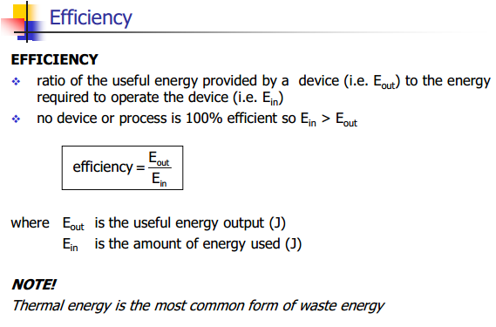

Slide 6
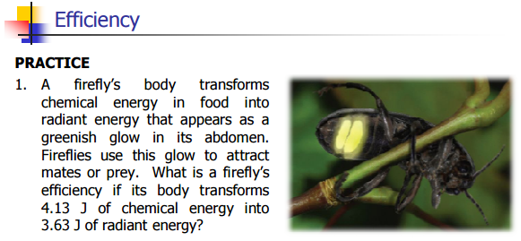

Slide 13
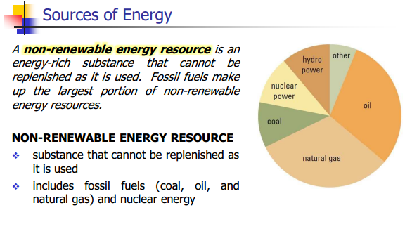

Slide 26
Classwork & Homework

