Slide 1
CH 4: Application of Forces
4.2 – Friction
4.3 – Solving Friction Problems

Slide 8
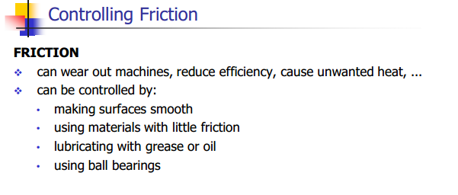

Slide 23
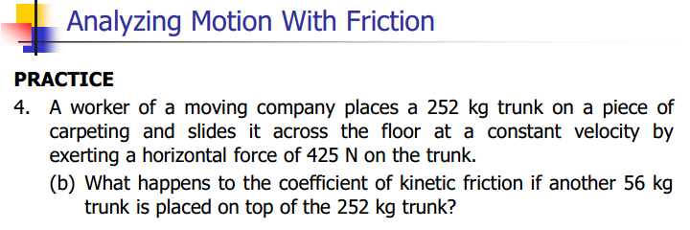

Slide 27
