Slide 1
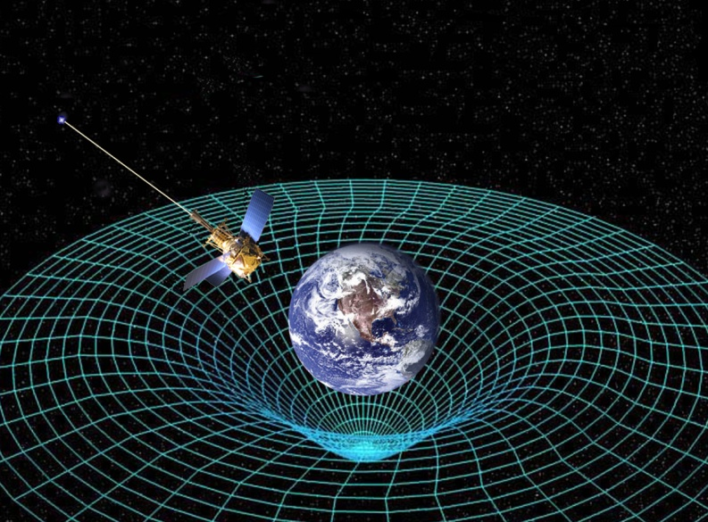
CH 4: Applications of Forces
4.1 – Gravitational Force Near Earth

Slide 7
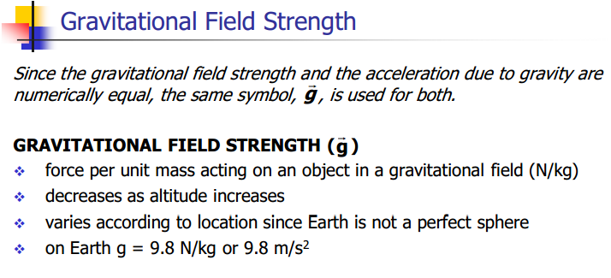

Slide 9
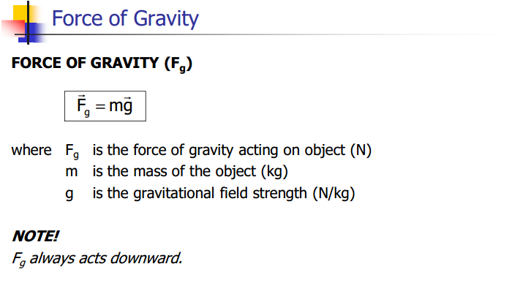

Slide 18
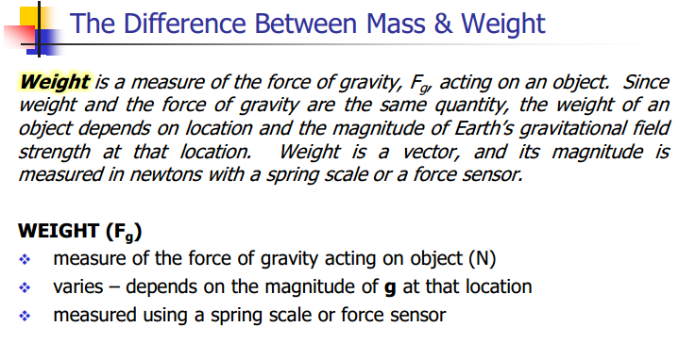

Slide 19
The difference between mass and weight
https://www.youtube.com/watch?v=_Z0X0yE8Ioc

Slide 28
Free falling in outer space
https://www.youtube.com/watch?v=tAUXIEr-VzM

Slide 29
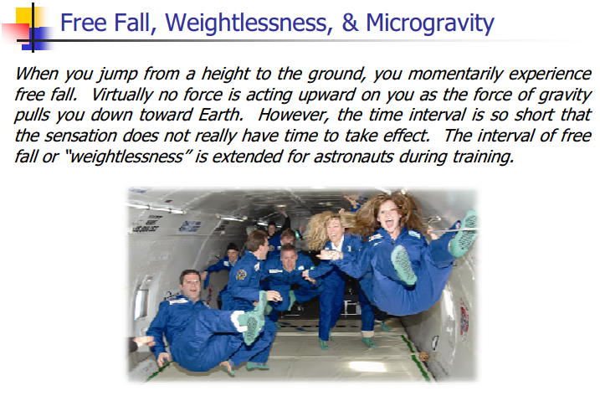

Slide 31
