Slide 1
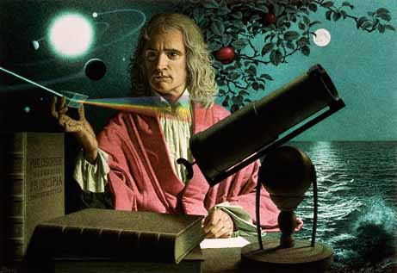
CH 3: Newton’s Laws of Motion
3.4 – Newton’s 3rd law of Motion

Slide 6
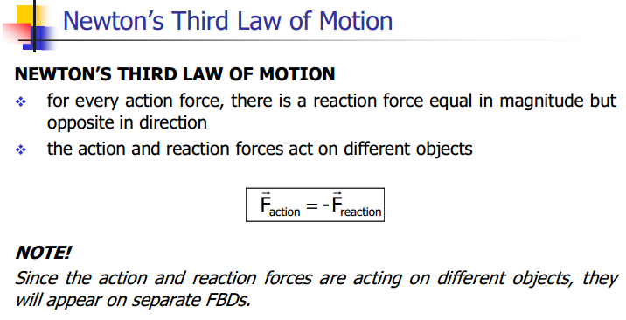

Slide 7
Newton’s 3rd Law: Jetpack Rocket Science (Veritasium)
https://www.youtube.com/watch?v=Hx9TwM4Pmhc

Slide 8
Newton’s 3rd Law: Science of NFL Football (National Science Foundation)
https://www.youtube.com/watch?v=e1lzB36aHD4

Slide 17
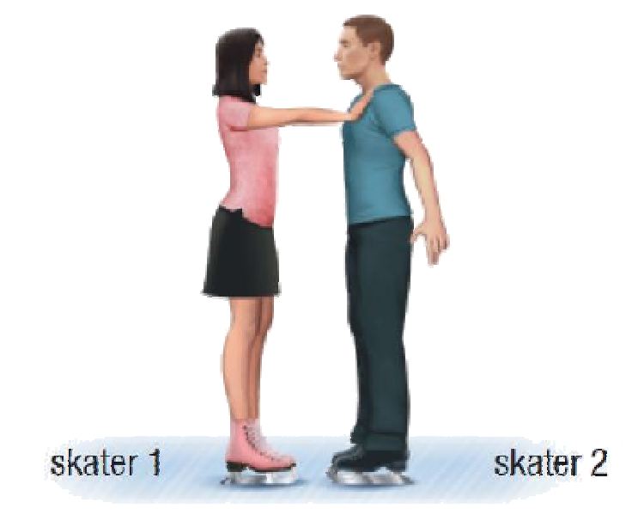
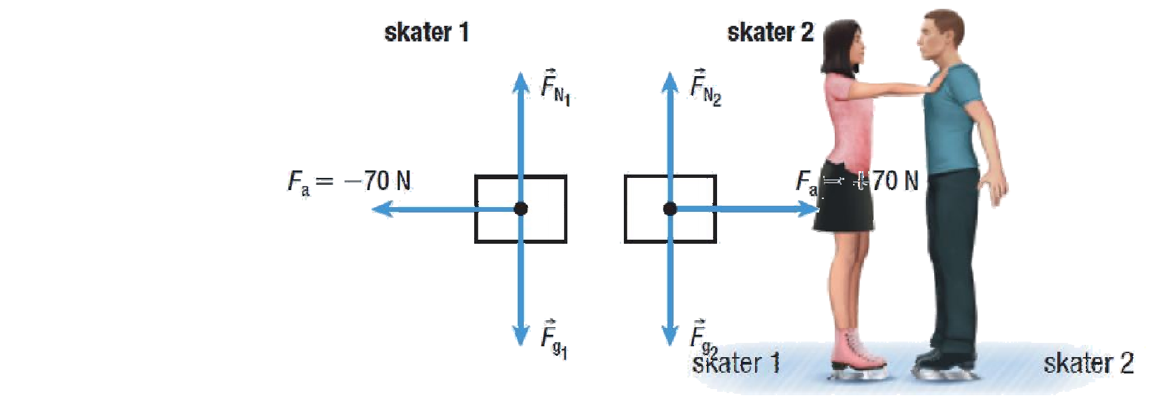

Slide 18
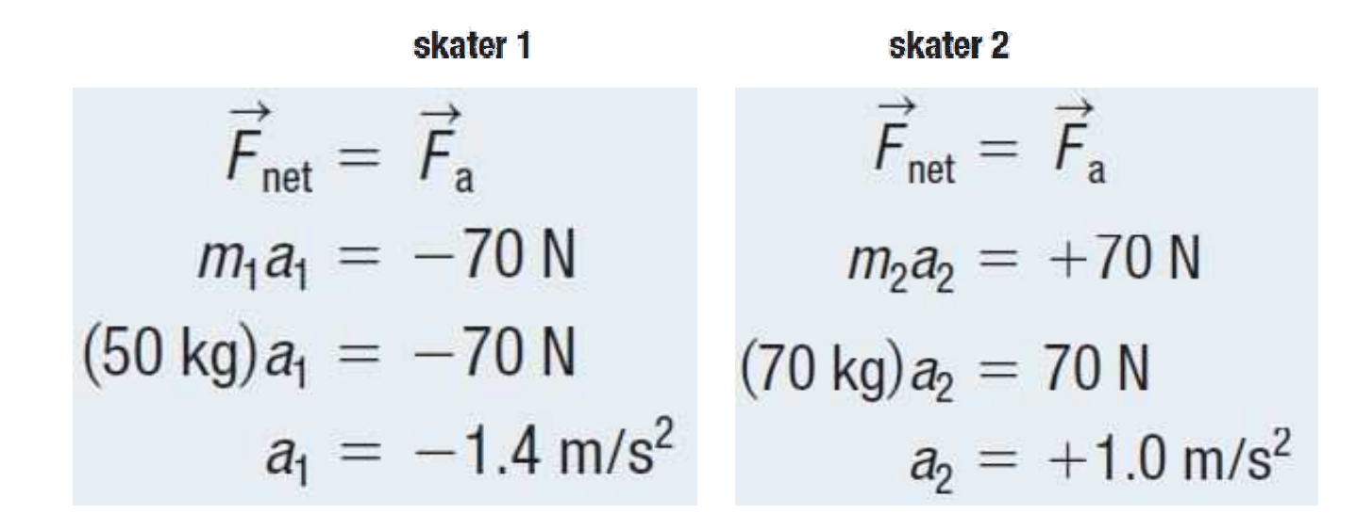

Slide 19
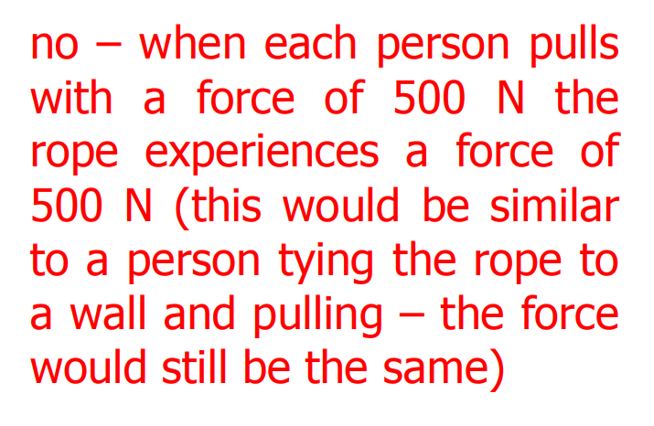

Slide 20
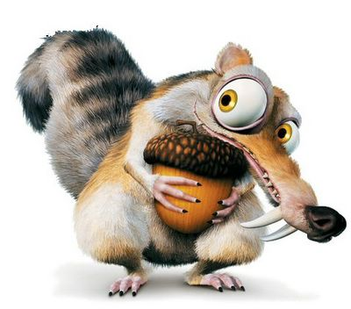

Slide 21
Classwork & Homework

