Slide 1
CH 2: Forces & Newton’s Laws of Motion
2.1 Forces of Nature

Slide 2
Learning Goals
State Newton’s three laws of motion and apply them to explain the observed motion of objects

Slide 3
Warm Up Question

Slide 4
Warm Up Question

Slide 11
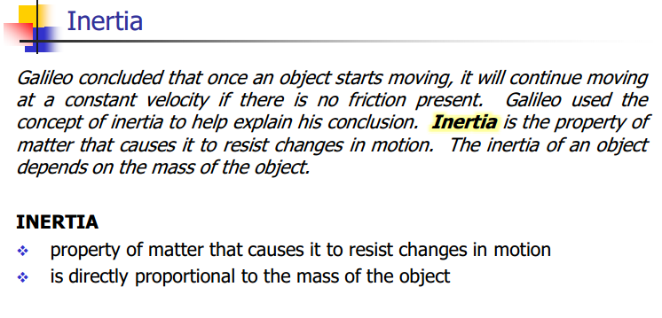

Slide 17
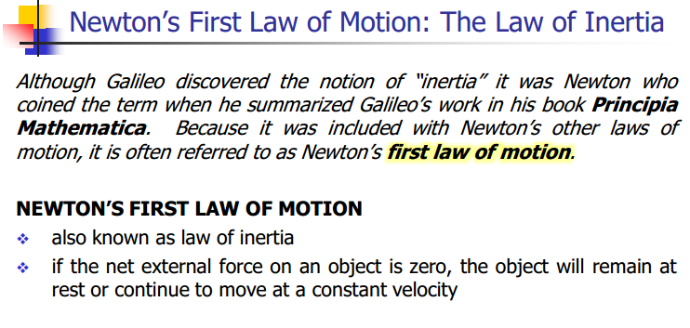

Slide 25
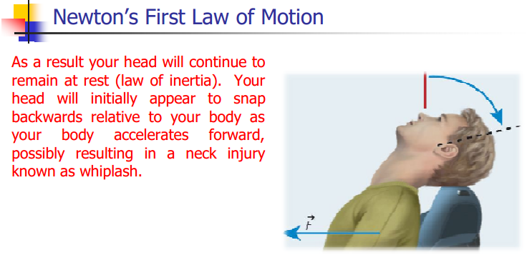

Slide 34
Classwork & Homework
Homework pg. 63 #6 and 7
Pg. 65 #1, 3, and 8

