Slide 1
SNC1D PHYSICS
THE CHARACTERISTICS OF ELECTRICITY
☹ Generating Electrical Energy
(P.476-485)

Slide 2
Electrical Energy
Every day, people all over the world use electrical devices to make their lives easier. Electric stoves cook our food, electric lights brighten our homes at night, and electric heaters keep us warm in the winter. But where does all this electrical energy come from?

Slide 3
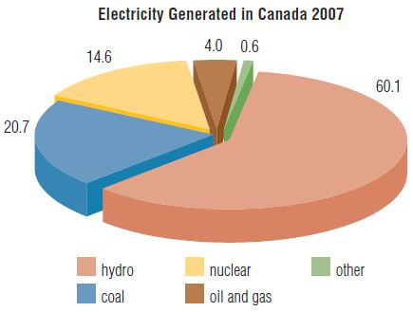
Sources of Electrical Energy
We obtain electrical energy from a variety of sources. Energy-rich substances such as crude oil and natural gas are commonly called energy resources. Some energy resources are considered non-renewable, while others are renewable.

Slide 4
Sources of Electrical Energy
A non-renewable energy resource is an energy-rich substance that cannot be replenished as it is used. Fossil fuels make up the largest portion of non-renewable energy resources.

Slide 5
Sources of Electrical Energy
NON-RENEWABLE RESOURCE
substance that cannot be replenished as it is used
includes fossil fuels (i.e. coal, oil, and natural gas) and nuclear energy

Slide 6
Sources of Electrical Energy
A renewable energy resource is an energy-rich substance with an unlimited supply or a supply that can be replenished as the substance is used.

Slide 7
Sources of Electrical Energy
RENEWABLE RESOURCE
substance with an unlimited supply or a supply that can be replenished as it is used
includes hydroelectricity and other small sources (i.e. solar, wind, tidal, geothermal, biomass and fusion)

Slide 8
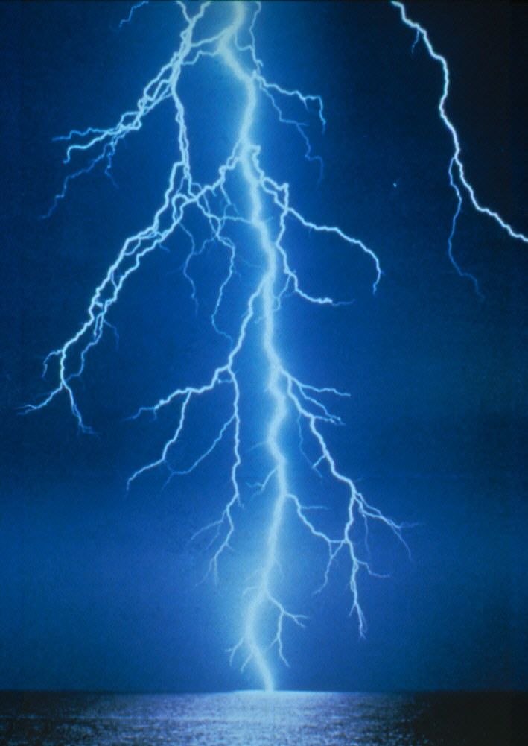
Sources of Electrical Energy
NOTE!
Although electrical energy exists naturally in the form of lightning no one has yet found a way to control lightning or a way to store the huge amounts of energy that are released in a few fractions of a second. An additional problem is that it occurs quite randomly, and in some areas of the world lightning hardly occurs at all.

Slide 9
Sources of Electrical Energy
LIGHTNING
only naturally occurring source of electrical energy
two major problems:
 too much energy, too fast
 occurs randomly or not at all

Slide 10
Sources of Electrical Energy
PRACTICE
1. Although renewable energy resources are replaceable or unlimited in supply, non-renewable energy resources such as coal, oil, and natural gas continue to be the most widely used sources of electrical energy in the world today. Why? (Hint: there are two major reasons.)
 Much of today’s technology is designed to transform the chemical energy in fossil fuels into other forms of energy.
 The large-scale, global use of fossil fuels and fossil fuel-using devices keeps their prices relatively low.

Slide 11
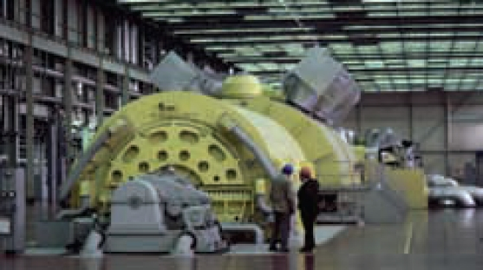
Generating Electrical Energy
Most of the electrical energy distributed by the power grid is produced in electrical energy generating stations. These stations use large machines called generators to produce electrical energy. A generator is a machine that converts mechanical energy into electrical energy.

Slide 12
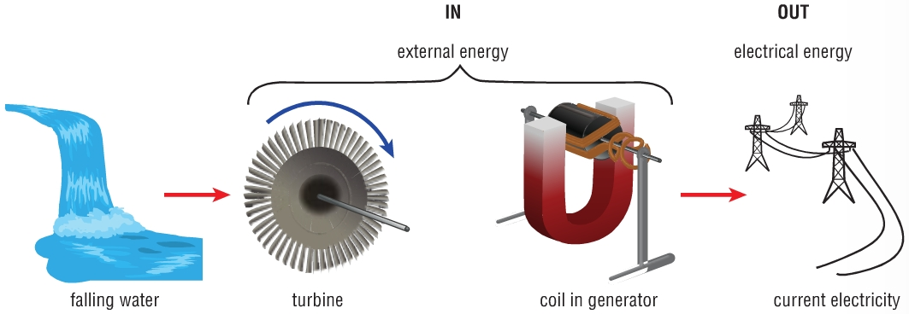
Generating Electrical Energy
A basic generator consists of a magnet and a wire coil. Recall that magnets have two different poles: north and south. Magnetism at these poles can cause a push or a pull. When the wire coil rotates near the magnetic poles, the negatively charged particles in the wire are forced to move. This is how electrical energy is generated. The faster the wire coils are rotated, the more electricity that is generated.

Slide 13
Generating Electrical Energy
The energy in wind, flowing water, or steam can be converted into electrical energy. The movement is used to push the blades of a fan-like device called a turbine. The turbine is connected to the wire coils inside a generator. When the turbine spins, the coils of wire generate electrical energy as they spin at high speed near powerful magnets.

Slide 14
Generating Electrical Energy
GENERATOR
machine that converts mechanical energy into electrical energy
consists of a magnet and a wire coil
when the wire coil spins near a magnet electricity is generated

Slide 15
Generating Electrical Energy
TURBINE
fan-like device connected to wire coil
energy in wind, flowing water, or steam is used to spin the turbine
the faster the wire coil spins the more electricity is generated

Slide 16
Generating Electrical Energy
PRACTICE
2. The three main sources of electrical energy production in Ontario are fossil fuel, nuclear energy, and hydroelectric. Complete a chart similar to the one below detailing the type of energy, how and how much electrical energy is produced by each and some advantages and disadvantages of each?
 | Fossil Fuel | Nuclear | Hydroelectric
Type
How?
%
Pro
Con

Slide 17
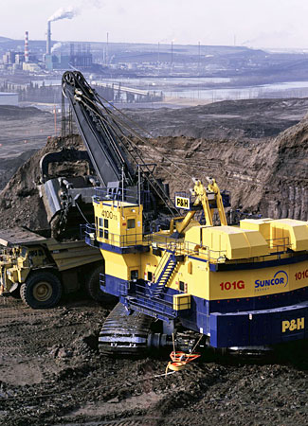
Generating Electrical Energy – Fossil Fuels
Fossil fuels are recovered from the ground in raw form. They then undergo some form of energy transformation to make them useful. When burned directly, the fuel products can be used to operate the engines of vehicles and furnaces to heat buildings.
NOTE!
As the supply of oil and natural gas diminishes, less conventional fossil fuel resources, such as Western Canada’s tar sands, will become more important.

Slide 18
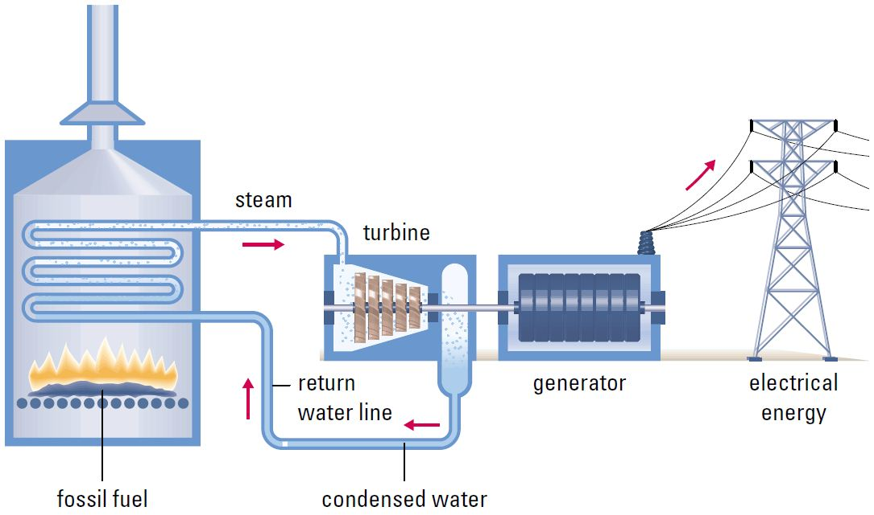
Generating Electrical Energy – Fossil Fuels
The fuel products can also be used to generate electricity. In this process, the fossil fuel is burned to produce steam, which in turn drives large turbines connected to huge electric generators.

Slide 19
Generating Electrical Energy – Fossil Fuels
DYK?
Ontario obtains about 36% of its electricity from generating stations using fossil fuels.

Slide 20
Generating Electrical Energy – Fossil Fuels
NOTE!
While fossil fuels are much less expensive to use than other sources, it does have some disadvantages including:
releases carbon dioxide and other greenhouse gases into the air which contributes to climate change
obtaining fossil fuels destroys habitats
burning fossil fuels causes pollution including acid precipitation
uses large volumes of water to cool and condense steam, which can cause thermal pollution

Slide 21
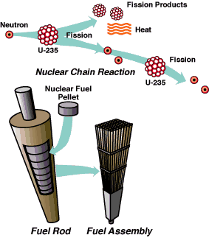
Generating Electrical Energy – Nuclear
Nuclear energy is a form of potential energy that is used for the generation of electricity. Uranium undergoes nuclear fission, in which the nucleus (core) of each atom splits and, in doing so, releases a relatively large amount of thermal energy.
NOTE!
The combination of smaller nuclei to form larger nuclei is called nuclear fusion, which is the power source of the Sun.

Slide 22
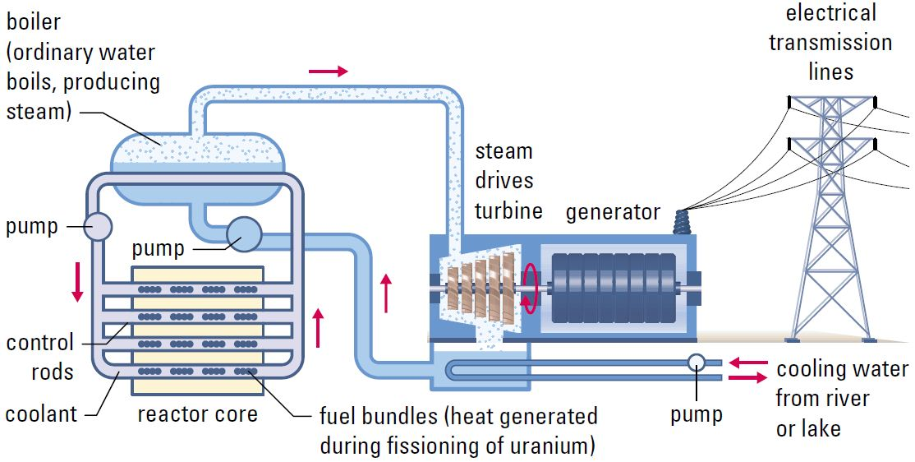
Generating Electrical Energy – Nuclear
Thus, for electrical energy production, uranium serves the same function as fossil fuels. The uranium undergoes fission to produce steam, which in turn drives large turbines connected to huge electric generators.

Slide 23
Generating Electrical Energy – Nuclear
DYK?
Ontario obtains about 37% of its electricity from generating stations using nuclear energy.

Slide 24
Generating Electrical Energy – Nuclear
NOTE!
While nuclear fission does not cause air pollution directly nor emit greenhouse gases directly, it does have some disadvantages including:
produces radioactive wastes that will remain unsafe for tens of thousands of years
mining uranium results in air, water, and land pollution
expensive to build and maintain
uses large volumes of water to cool and condense steam, which can cause thermal pollution

Slide 25
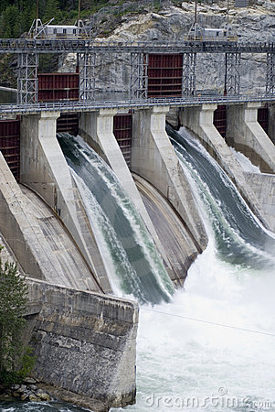
Generating Electrical Energy – Hydroelectric
The kinetic energy of rushing water is transformed into electrical energy (electric current) in a hydroelectric power plant. Electrical energy produced in this way is called hydroelectricity or simply, hydro.
NOTE!
Hydroelectric power plants produce more electrical energy than any other renewable energy resource in the world.

Slide 26
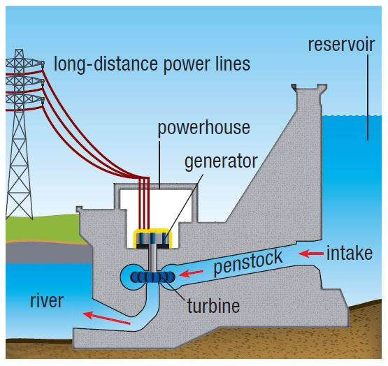
Generating Electrical Energy – Hydroelectric
With a hydroelectric power plant, a dam is built to create a large reservoir of water. As water in the reservoir falls through the penstock, it gains kinetic energy and strikes the blades of turbines at the lower end. This spins the turbines which then drive huge electric generators attached to the turbines.

Slide 27
Generating Electrical Energy – Hydroelectric
DYK?
Ontario obtains about 26% of its electricity from hydroelectric generating stations.

Slide 28
Generating Electrical Energy – Hydroelectric
NOTE!
While hydroelectric does not release pollution into the air or water, it does have some disadvantages including:
disrupts the natural water flow
can restrict fish movement
large area behind dam is flooded which results in habitat loss
they are expensive to build
difficult to find suitable locations for new ones

Slide 29
Generating Electrical Energy – Comparison of …
 | Fossil Fuel | Nuclear | Hydroelectric
Type
How?
%
Pro
Con
 Non-renewable
 Non-renewable
 Renewable
 fuel is burned
 heat boils water
 steam turns a
generator
 fission of atoms
 heat boils water
 steam turns a
generator
 water is dammed
 falling water turns a
generator
 36
 37
 26
cheap to use
technology in place
produces lots of energy
no pollution (directly)
plentiful in Ontario
reservoirs are useful
 pollution & acid rain
global warming
mining destroys habitats
thermal pollution
 potential for disaster
storage of spent fuel
$ to build & maintain
thermal pollution
destroys habitats
displaces people
$ to build
new locations?

Slide 30
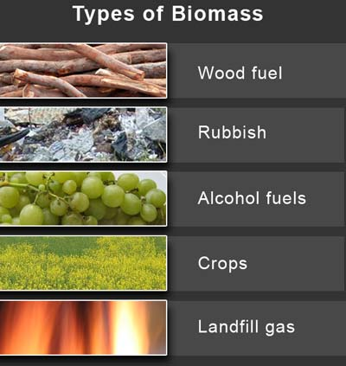
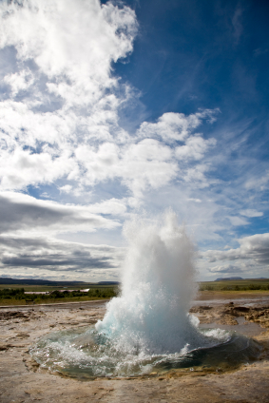
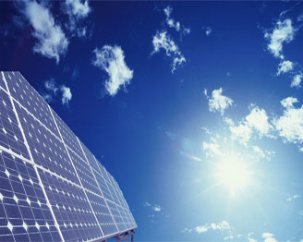
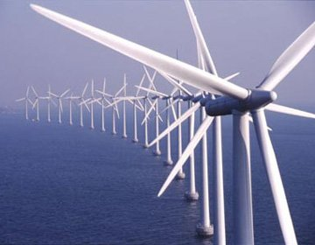
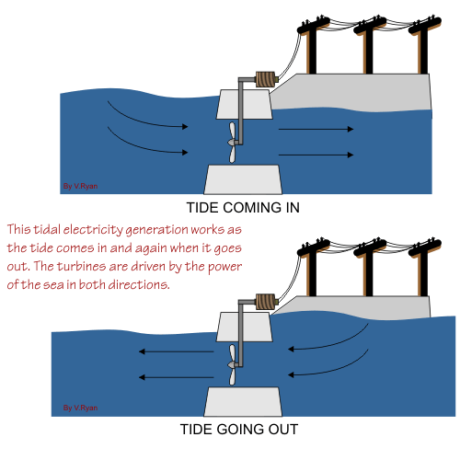
Alternate/Small Energy Resources
NOTE!
Alternative and small energy resources supply the remaining 1%. These include:
biomass
geothermal
solar
wind
tidal

Slide 31
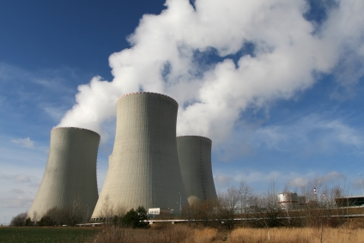
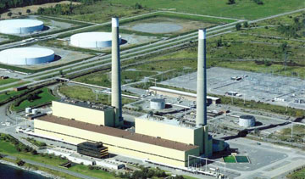
Conserving Energy – The Future
One fact is certain in Ontario. We are going to need to generate increasing amounts of electrical energy far into the foreseeable future. Our population and economy are growing, which means that we will need more electricity. However, none of the renewable energy sources can currently be manufactured and operated cheaply enough to make them a viable alternative in the foreseeable future. And so the logical conclusion, then, is that we will have to build new generating stations that use the same nonrenewable energy resources as our existing generating stations.

Slide 32
Conserving Energy – The Future
Regardless, energy may be conserved by designing, producing, and using machines, appliances, and devices that transform energy more efficiently. Energy may also be conserved by:
turning lights off when not required
switching off electrical devices instead of leaving them on standby mode
taking short showers instead of baths if possible
running dishwashers and clothes washers only when they are full
hanging clothes to dry
using fans to reduce the need for air conditioning
using public transit and car-pooling when possible

Slide 33
Conserving Energy – The Future
ENERGY DEMAND IN ONTARIO
our population/economy is growing so we will need more (electricity)
only option is to build more (nonrenewable) generating stations
regardless, energy may be conserved by:
turning lights and other electrical devices off
taking short showers
running dish/clothes washers only when they are full
hanging clothes to dry
using fans to reduce the need for air conditioning
using public transit and car-pooling when possible
…

Slide 34
 Check Your Learning
1. An article on the Internet claims, “Fossil fuels are actually a renewable energy resource since decaying plant and animal matter is making new oil, natural gas, and coal all the time.” Discuss the validity of this statement.
a resource is deemed “renewable” only if it can be replaced as it is used (i.e. within a lifetime) – fossil fuels take millions of years to form

Slide 35
 Check Your Learning
2. Which alternative energy resource is most likely to be developed in your area? Explain why.
wind – lots of it and great location (i.e. sparsely populated/remote)

