Slide 1
INCOME MANAGEMENT
BBI2O1

Slide 2
BASIC TERMINOLOGY
Personal Income
Gross Income
includes compensation from a number of sources - salaries, wages and bonuses received from employment or self-employment; dividends and distributions, etc.
Disposable Income (referred to as take-home pay)
The amount of money that households have available for spending and saving after income taxes and other deductions have been accounted for, such as CPP, EI, etc.
Discretionary Income
The amount of an individual's income that is left for spending, investing or saving after taxes and personal necessities (such as food, shelter, and clothing) have been paid.
Income tax calculator
Source: http://www.investopedia.com/terms/d/discretionaryincome.asp#ixzz2HLAlcdX1

Slide 3
BASIC TERMINOLOGY
Business Income
Gross Income
Total revenue subtract cost of goods sold
Net Income
Gross Income subtract the costs to operate a business (rent, salaries, etc.)
Source: http://www.investopedia.com/terms/d/discretionaryincome.asp#ixzz2HLAlcdX1

Slide 4
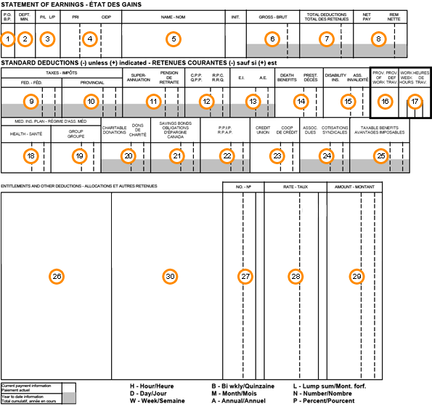
PAYROLL STUB

Slide 5
CALCULATING GROSS and NET INCOME

Slide 6
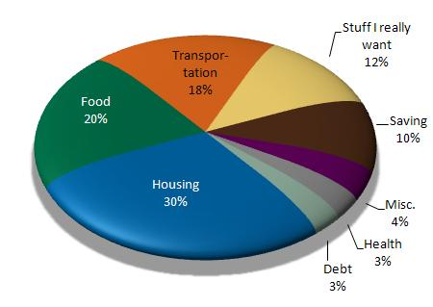
WHERE DOES OUR DISPOSABLE INCOME GO?

Slide 7
FACTORS THAT INFLUENCE OUR BUYING DECISIONS
What influences how you spend your money?
Income and price
Status
Current Trends
Customs and Habits
Promotion

Slide 8
FACTORS THAT INFLUENCE HOW WE SPEND
What factors should you consider when spending money?
Comparing price and quality
Features
Services
Planning and comparing

Slide 9
BEST TIME TO BUY
When is the best time to buy?
Clearance sales
Promotional sales
Second-hand shopping
Avoiding impulse-shopping

Slide 10
Places to Buy, goods and services and advantages and disadvantages of each.
Department stores – The Bay
Discount stores – Dollarama
Factory outlets – Reebok
Specialty stores – EB Games
Supermarkets –Longos
Convenience stores – 7 Eleven
Warehouse clubs – Costco
Big box stores – Best Buy
Online shopping – Amazon

Slide 11
Canadians and Debt
https://www.youtube.com/watch?v=72WmOCL_P5I

Slide 12
Budget – Til Debt Do Us Part
https://youtu.be/1pQJxGIFzdo

Slide 13
Getting Debt under Control
Can’t spend more money than you make.
You must save something.
You have to be actively paying off debt (paying more than the minimum payment) and paying off the debt within 3 years or less.
You need an emergency fund.
You need some balance in your life (need to have some joy).

Slide 14
Budgeting 101
Major parts of the budget
Fixed vs variable expenses
Fixed expenses are those costs that occur regularly and cannot be adjusted
Mortgage or rent, insurance payments and car payments
Variable expenses are expenses that differ from one month to another
Food, clothing, utilities, personal care and entertainment

Slide 15
Budgeting Activity
Read pages 380 – 384
Understand the purpose of a budget and how a budget is prepared
In groups of 3-4 discuss and complete the Family Budget
Share your answers with the class

