Slide 1
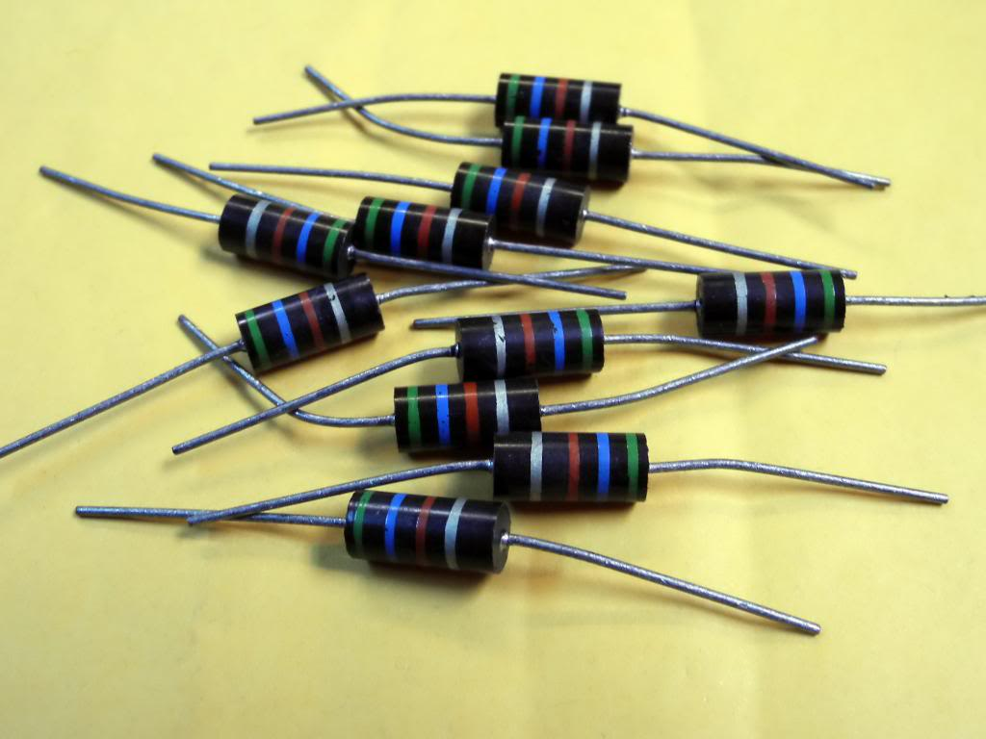
CH 11: Electricity and Its Production
11.9 – Circuit Analysis

Slide 2
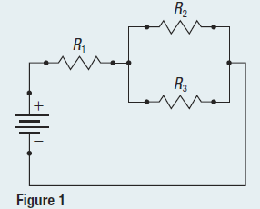
Pg. 532 #1

Slide 4
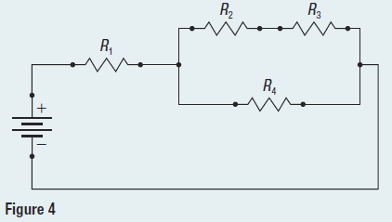
Pg. 534 #1

Slide 6
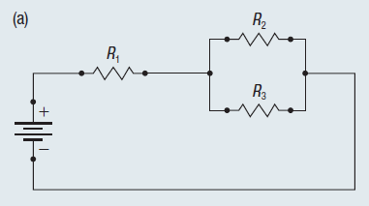
Pg.535 #1a

Slide 7
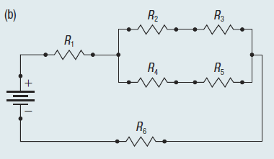
Pg.535 #1b

Slide 10
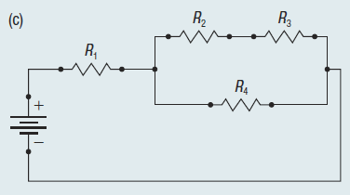
Pg.535 #1c

Slide 11
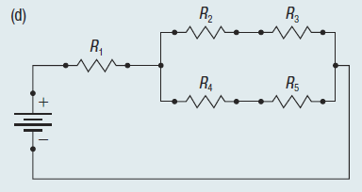
Pg.535 #1d

Slide 12
Pg.535 #2

Slide 13
Pg.535 #3

Slide 14
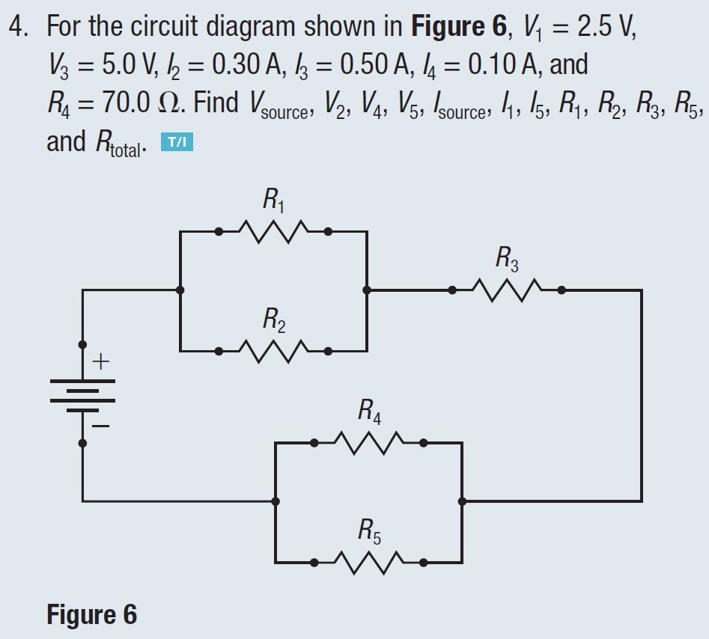
Pg.535 #4

Slide 15
Extra Practice Questions

