Slide 1
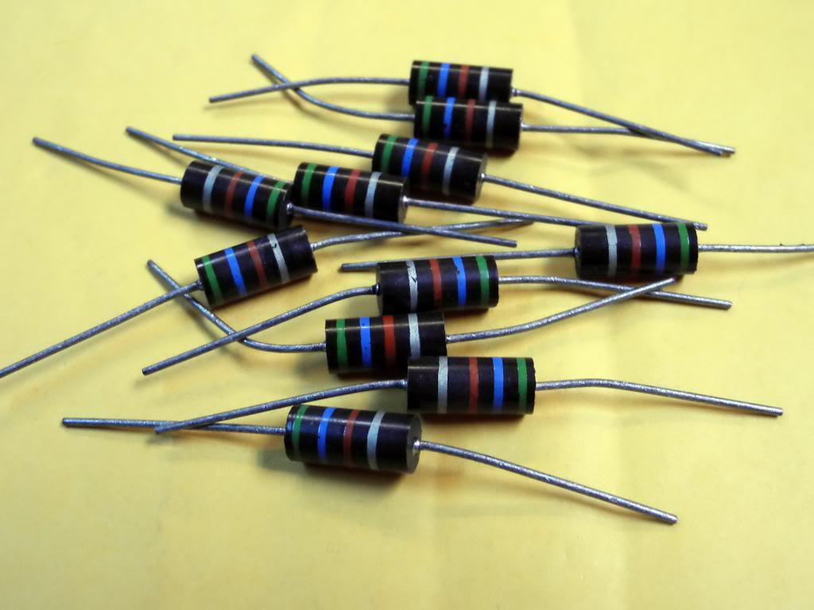
CH 11: Electricity and Its Production
11.9 – Circuit Analysis

Slide 2
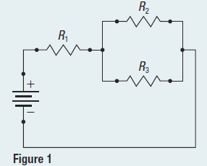
Pg. 532 #1

Slide 3
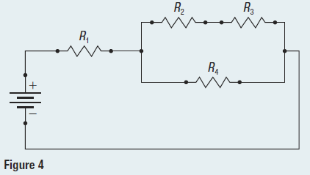
Pg. 534 #1

Slide 4
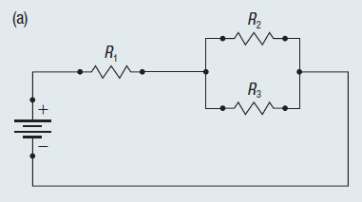
Pg.535 #1a

Slide 5
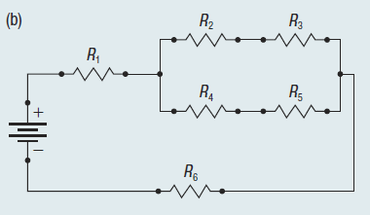
Pg.535 #1b

Slide 6
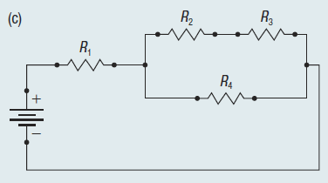
Pg.535 #1c

Slide 7
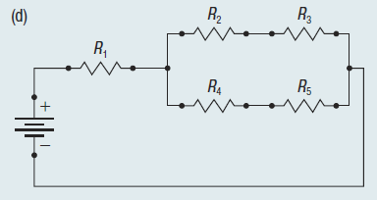
Pg.535 #1d

Slide 8
Pg.535 #2

Slide 9
Pg.535 #3

Slide 10
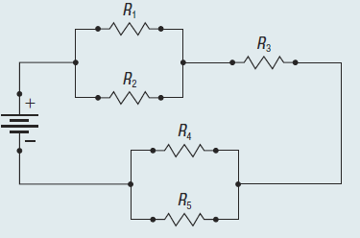
Pg.535 #4

Slide 11
Extra Practice Questions

Slide 14
Classwork & Homework

